Slide 1
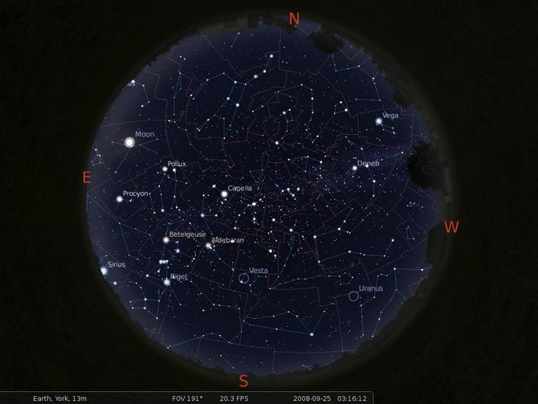
Relational Databases Fundamentals
AN ASTRONOMICAL VIEW
L. Nicastro, INAF-OAS Bologna, 3-7 June 2018
nicastro@iasfbo.inaf.it
http://ross2.iasfbo.inaf.it/wp/imprs18/

Slide 2
Introduction
A Database Management System (DBMS) is a software system designed to manage and give access to data collections of very large size, shared and persistent, in an efficient and secure way.
A Database is a collection of data managed by a DBMS.
RDBMS: an astronomical view. LN @ INAF - OAS Bologna

Slide 3
Database: when
All the web apps and management systems handling not static or large amount of data use a database system.
Large amount of data
Accessibility
Reliability
In science the hardest challenge is the “variety” of data to manage not only their quantity.
RDBMS: an astronomical view. LN @ INAF - OAS Bologna

Slide 4
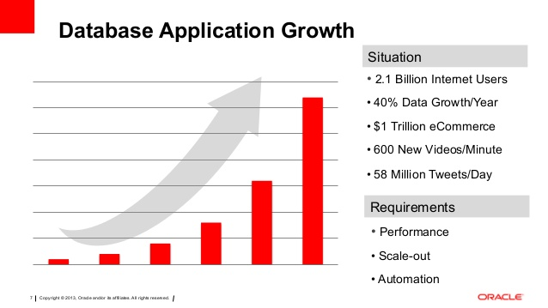
Database: where
Found on any device, from your smartphone to the web giants distributed systems! The number of active systems is almost impossible to estimate.
Your PC
Your Inst.
The Web
RDBMS: an astronomical view. LN @ INAF - OAS Bologna

Slide 5
A database of the past
TABLE
ROW
INDEX
TABLES
COLUMN
RDBMS: an astronomical view. LN @ INAF - OAS Bologna

Slide 6
Basic concepts for a relational database
As usual, please use the web as a reference for anything.
Database nomenclature:
table
record
field
key
query
SQL
DBMS
RDBMS: an astronomical view. LN @ INAF - OAS Bologna

Slide 7
Database terms
table
It’s a collection of data organized as rows and columns.
Each table, in general, represents a collection of information for a specific argument or subject.
For example we can have a table dedicated to the students, one for the teachers and one for the courses.
record (row, instance, tuple)
A single row of data in the table.
It allow us to identify a single set of data, one per field, among all those present in the table.
field
These are the cells of each column that are present in the table that define its structure; you can specify the type (format) of each column (textual, numeric, integer, floating, etc.) and a set of rules can be imposed, e.g. that a field cannot be void (null) or must have a maximum number of characters.
RDBMS: an astronomical view. LN @ INAF - OAS Bologna

Slide 8
The most basic component: a table
It’s the reference structure of a database.
TABLE
SCHEMA
COLMNS
FIELDS
Code (integer) | Name (character) | N_hours (real) | Semester (integer) | Credits (integer)
010 | Databases | 72.5 | 1 | 9
022 | Algorithms | 90.3 | 1 | 12
… | … | … | … | …
METADATA
ROWS
INSTANCES
We can identify the above table, e.g. as “courses”
The most common data types are: integer, real (float), character (string), date (timestamp).
RDBMS: an astronomical view. LN @ INAF - OAS Bologna

Slide 9
Database terms: key
keys (primary, candidate, external)
A key is a single or group of fields that allows to identify in a unique way a single record or a subset within the table.
A key can be composed by one or more fields.
Each table can have one or more keys.
In a table cannot exist two distinct records with the same primary/unique key field.
Cannot exist primary/unique keys containing NULL values.
It’s a fundamental component of relational databases.
RDBMS: an astronomical view. LN @ INAF - OAS Bologna

Slide 10
Database terms: query
query
It is a Database interrogation aimed at extracting, reorganizing, reclassifying, manage its data.
As a result it provides a set of data that satisfy the given conditions.
Normally the DBMS or application provided tools allow the user to build queries.
Web interfaces exist to facilitate SQL queries building and check, either writing it directly or built by selecting a set of parameters.
RDBMS: an astronomical view. LN @ INAF - OAS Bologna

Slide 11
Database terms: SQL – 1
SQL (Structured Query Language - pronounced “ES-Q-EL”)
It’s the language used to access and manage the data in a (R)DBMS, to create and modify the structure of the database, to manage the access to the objects it hosts.
Though SQL is a ANSI e ISO standard, many RDBMS support extensions of the language. The first version was developed by IBM at the beginning of the ‘70 by D. D. Chamberlin and R. F. Boyce with the name SEQUEL. IBM patented this version of the language in 1985 calling it SQL, and in 1986 it was standardised by the American National Standards Institute. The following versions were released as standard by the International Standardisation Organization (ISO). Current standard version is SQL:2016.
RDBMS: an astronomical view. LN @ INAF - OAS Bologna

Slide 12
Database terms: SQL – 2
It’s not an imperative/procedural language, but rather a declarative language: it lacks the concept of variable and algorithm control structure typical of the imperative languages and structured programming.
It’s made of 3 (4) instruction sets:
DDL (Data Definition Language): to define the structure of the database
DCL (Data Control Language): to manage the criteria of data access and protection
DML (Data Manipulation Language): to operate on the data
TCL (Transactional Control Language): to manage the various transactions in the DB. E.g. COMMIT, ROLLBACK.
RDBMS: an astronomical view. LN @ INAF - OAS Bologna

Slide 13
Database terms: SQL – 3
Query in SQL
A query written in SQL has the typical form:
Select – From – Where
– SELECT: to choose the fields to retrieve (* for all)
– FROM: to choose on which table(s) the query must be performed
– WHERE: to constraints to be used for the rows selection
Example:
SELECT Name, N_hours, Credits
FROM Courses
WHERE Code=22;
Can be used to build scripts, functions and procedures.
Most used commands: SELECT, INSERT, DELETE, UPDATE.
RDBMS: an astronomical view. LN @ INAF - OAS Bologna

Slide 14
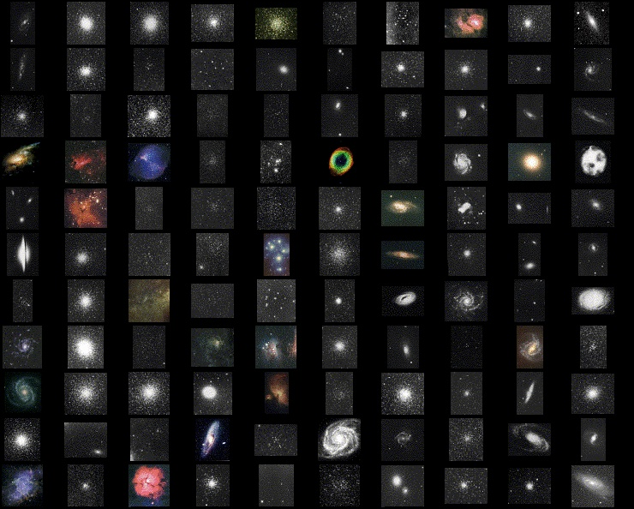
Messier catalogue
11
.
.
.
2
1
RDBMS: an astronomical view. LN @ INAF - OAS Bologna

Slide 15
The Messier catalogue
Metadata
M Type Const Mag Ra_h Ra_m Dec_d Dec_p Dist App_size
int string string float float float float float string string
1 BN Tau 8.2 05 34.5 +22 01.0 6.3 kly 6'x4'
2 GC Aqu 6.3 21 33.5 00 -49.0 36.2 kly 12.9’
3 GC CVn 6.3 13 42.2 +28 23.0 30.6 kly 16.2'
4 GC Sco 6.4 16 23.5 -26 31.5 6.8 kly 26.3'
5 GC Ser 6.2 15 18.6 +02 05.0 22.8 kly 17.4'
6 OC Sco 4.2 17 40.4 -32 13.8 2 kly 33'
7 OC Sco 4.1 17 53.9 -34 47.0 800 ly 80.0'
8 BN Sag 6.0 18 04.1 -24 18.0 5200 ly 90'x40'
9 GC Oph 7.3 17 19.2 -18 31.0 26.4 kly 9.3’
− Data −
Data + metadata = file FITS, VOTable, etc.
Data + metadata + software = DATABASE !
RDBMS: an astronomical view. LN @ INAF - OAS Bologna

Slide 16
Database: where to look
en.wikipedia.org/wiki/Relational_database
dev.mysql.com / mariadb.org
postgresql.org
sqlite.org
mongodb.com
RDBMS: an astronomical view. LN @ INAF - OAS Bologna

Slide 17
Database: which to choose
It depends on what what to manage and how you access it.
Our choice:
Language: SQL
Relational
Local and remote
RDBMS: an astronomical view. LN @ INAF - OAS Bologna

Slide 18
The Messier catalogue: SQL first hints
DROP TABLE IF EXISTS Messier;
CREATE TABLE Messier (
M int NOT NULL,
Type CHAR(2) DEFAULT '**’,
Const CHAR(3) DEFAULT '***’,
Mag FLOAT,
Ra FLOAT,
Decl FLOAT,
Dist CHAR(20),
App_size CHAR(20) DEFAULT 'unknown’,
PRIMARY KEY(M), INDEX(Type)
);
RDBMS: an astronomical view. LN @ INAF - OAS Bologna

Slide 19
The Messier catalogue: SQL first hints
1.
LOAD DATA LOCAL INFILE './messier.tsv'
INTO TABLE Messier;
2.
SELECT *
FROM Messier
WHERE Mag < 2;
3.
UPDATE Messier
SET Ra = Ra * 15.0;
RDBMS: an astronomical view. LN @ INAF - OAS Bologna

Slide 20
Example: DB role for web applications
Base components of a modern web site are typically 4.
Web site
Can be
local
or
remote
CSS3
Appearence
JavaScript
Content management
HTML5
Skeleton
PHP
Server side operations
database
DATA
RDBMS: an astronomical view. LN @ INAF - OAS Bologna

Slide 21
Course aims
Understand peculiarities of the "database" (in its wider meaning) with respect to the data management as "file" (e.g. Excel spreadsheets),
Understand and use a minimal set of SQL commands, in particular to insert data into database (INSERT) and read them (SELECT),
Understand and use, in particular SELECT, queries to access and "visualize" (as tables and graphics) astronomical data like objects catalogues at various wavelengths, freely accessible from the web, or your own custom data.
RDBMS: an astronomical view. LN @ INAF - OAS Bologna

Slide 22
More and more data for everybody
In Informatics, the base definition of data is:
“a sequence of bytes”, generally organized as a “file”
Unit | Equivalent in bytes
1 byte (B) | 8 bit
1 kilobyte (KB) | 1,024 bytes
1 megabyte (MB) | 1,048,576 bytes
1 gigabyte (GB) | 1,073,741,824 bytes
1 terabyte (TB) | 1,099,511,627,776 bytes
1 petabyte (PB) | 1,125,899,906,842,624 bytes
1 exabyte (EB) | 1,024 PB
1 zettabyte (ZB) | 1,024 EB
1 yottabyte (YB) | 1,024 ZB
RDBMS: an astronomical view. LN @ INAF - OAS Bologna

Slide 23
More and more data for everybody
Year | IP traffic (PB/month) | Fixed Internet traffic (PB/month) | Mobile Internet traffic (PB/month)
2005 | 2,426 | 2,055 | 0.9
2006 | 3,992 | 3,339 | 4
2007 | 6,430 | 5,219 | 15
2008 | 10,174 | 8,140 | 33
2009 | 14,686 | 10,942 | 91
2010 | 20,151 | 14,955 | 237
2011 | 30,734 | 23,288 | 597
2012 | 43,570 | 31,339 | 885
2013 | 51,168 | 34,952 | 1,480
2014 | 59,848 | 39,909 | 2,514
2015 | 72,521 | 49,494 | 3,685
Font Cisco Systems + Wikipedia
RDBMS: an astronomical view. LN @ INAF - OAS Bologna

Slide 24
More and more data for everybody
(PB)
Font Cisco Systems + Wikipedia
( Video )
RDBMS: an astronomical view. LN @ INAF - OAS Bologna

Slide 25
Folders and files
Textual files
Binary files
Can only contain “text”.
Do not need a document manager (e.g. Word), a “text editor” is enough.
Can use various code sets, e.g. ASCII, UTF-8, etc.
Errors in the content do not affect readability and it is “spottable” aa open / visualization time. For this reason, e.g. Microsoft starting from Office 2007 uses XML – “compressed” text format.
Contain (any) “bytes sequence”.
Can represent various types of data, e.g. text, image, video, audio.
Can be managed and “visualized” only through “applications” that are able to interpret their content.
Errors even of just 1 bit can make the file unusable.
Note: the ASCII set uses 1 byte codes, therefore 2⁸ characters are possible.
RDBMS: an astronomical view. LN @ INAF - OAS Bologna

Slide 26
Data: management via file – 1
Most of the Informative Systems have the necessity to manage data in a persistent way.
No clear distinction between data and applications.
Application contains internally the logic for the management and storing of its data (e.g. the data format).
The Operative System offers the base components to access the files and the security mechanisms of the file-system.
FILES
APPLICATION
Read/Write operations on file
through the Operative System support
RDBMS: an astronomical view. LN @ INAF - OAS Bologna

Slide 27
Data: management via file – 2
PROBLEM 1: Big Data management?
Some (not quite) “extreme”:
More than 200 Terabyte of data (instant.)
244 Million customers subscribed
1.1 Billion orders per year
> 400 Terabyte of data
> 400 Million customers
> 2 Trillion calls records
AMAZON
AT&T
Obvious problems of scalability and efficiency …
RDBMS: an astronomical view. LN @ INAF - OAS Bologna

Slide 28
Data: management via file – 3
PROBLEM 2: Sharing and concurrent access?
In many practical scenario, data must be accessible by a multitude of user/applications with concurrent access.
Ex. University personnel
UNIVERSITY
PESONNEL
Personnel data
Salary data
DATI
CONTRACTS
OFFICE
STUDENTS
SECRATARIAT
Data of courses, exams, etc.
RDBMS: an astronomical view. LN @ INAF - OAS Bologna

Slide 29
Data: management via file – 4
PROBLEM 2: Sharing and concurrent access?
LIMITATIONS
Access to shared files occurs through file-system policy → Lock at file level, low concurrency granularity, low performance!
Various applications must know the exact location and format of the data → Update the data format?
An option: replicate the data at the various systems/users that use them → Consistency of the replica?
RDBMS: an astronomical view. LN @ INAF - OAS Bologna

Slide 30
DBMS: principles – 1
A database (DB) is a very large collection of related data, usually too large to fit into main memory and often used by many users simultaneously.
A database system implements real-world concepts and applications (entities, properties, relationships).
The invention of this database system has standardized the way data is stored and processed.
Most of the database systems in use today are based on the relational system. However other types of DBs exist, e.g. NoSQL or OODBs.
A relational database consists of a collection of tables (relations) that store particular sets of data among which relationships can exist.
RDBMS: an astronomical view. LN @ INAF - OAS Bologna

Slide 31
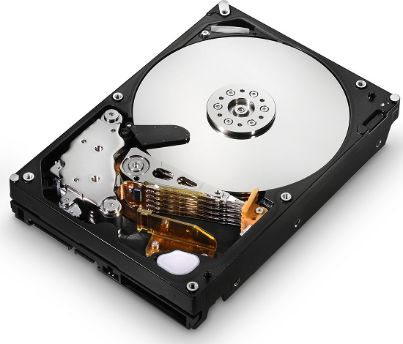
DBMS: principles – 2
A DBMS can be seen as a 3 levels software architecture
EXTERNAL SCHEMA
EXTERNAL SCHEMA
EXTERNAL SCHEMA
Describes how the DB
is presented to the user
LOGICAL SCHEMA
Describes what the DB represents
DBMS
PHYSICAL SCHEMA
Describes how/where
the data are stored
Mass memory
RDBMS: an astronomical view. LN @ INAF - OAS Bologna

Slide 32
DBMS: principles – 3
Application in all types of data management: banks, airlines and travel services, web applications, e-commerce, telecommunication, digital libraries, scientific data, etc.
The concept of a relational database derives from the principles of relational algebra, realized as a whole by the father of relational databases, E. F. Codd (1970 - A Relational Model of Data for Large Shared Data Banks).
This theory established that “data should be independent of any hardware or storage system, and provided for automatic navigation between the data elements”. In practice, this meant that data should be stored in tables (datasets) and that relationships could/would exist between these different datasets.
RDBMS: an astronomical view. LN @ INAF - OAS Bologna

Slide 33
DBMS: principles – 4
In practice, a nowadays relational database is implemented into a software package that serves a number of users connecting and performing queries via internet. In other words it implements a client-server system where the server can also be “distributed”. We can refer to it as a Database Management System (DBMS or RDBMS).
Interaction with a DBMS is performed via queries written using the Structured Query Language (SQL).
RDBMS: an astronomical view. LN @ INAF - OAS Bologna

Slide 34
DBMS: principles – 5
DBMS compared to a simple file I/O:
Data independence.
Efficient and concurrent data access.
Data security and consistency.
Data integrity under updates.
Uniform data administration.
Reduced application development time.
Recovery from crashes.
RDBMS: an astronomical view. LN @ INAF - OAS Bologna

Slide 35
DBMS: characteristics
Separation Data − Applications in DBMS
DBMS
APPLICATION
FILES
M1
DB
M2
Logical access
to the data
M2
Physical access
to the data
Moduli del DBMS
Using a DBMS, it is possible to implement a paradigm of separation of the data from the applications …
Applications do not have to know the physical structure of the data (e.g. where and how they are stored on the disk) but only the logical structure (what they represent).
RDBMS: an astronomical view. LN @ INAF - OAS Bologna

Slide 36
DBMS: characteristics (2)
Separation Data − Application in DBMS
“Tell me the code
of the course held
by John White”
DBMS
Read the file data.db
from byte N
to byte N+2
FILES
APPLICATION
M1
DB
M2
Language
DDL/DML
M2
Moduli del DBMS
DBMS-BASED
APPROACH
Read the file file.txt
from row N
to row N+1
CONVENTIONAL
APPROACH
APPLICATION
FILES
RDBMS: an astronomical view. LN @ INAF - OAS Bologna

Slide 37
DBMS: structure
A typical DBMS has a layered architecture.
Connection + user validation
Query Optimization
and Execution
Query syntax control
Relational Operators
Preliminary Tasks
Files and Access Methods
These layers must consider concurrency
control and recovery
(not shown here)
Buffer Management
Disk Space Management
Mass
Memory
RDBMS: an astronomical view. LN @ INAF - OAS Bologna

Slide 38
DBMS: reduced application development time
Higher level of data abstraction.
Application portability.
Queries are written in a high level language (SQL) tailored for database applications. Example:
SELECT StarName
FROM StarCatalogue
[ WHERE class = 3 ]
In terms of relational algebra it is:
- what to get
- from which dataset
- optionally applying a filter
SELECT L
FROM R
WHERE C
π_{L} ( σ_{C} (R) )
RDBMS: an astronomical view. LN @ INAF - OAS Bologna

Slide 39
DBMS: the Structured Query Language (SQL)
Mnemonic, more similar to spoken language, extensible, etc.
For example the syntax of a SELECT query is as follows:
SELECT StarName, ra, de FROM StarCatalogue
WHERE class = 3 ORDER BY ra
SELECT nominates which components of the matches made against the data should be returned.
FROM indicates the sources for the data against which to find matches.
WHERE (optional) defines patterns to match against the data.
ORDER BY (optional) defines a means to order the selected matches.
Note: produce a relation (table) from a relation.
RDBMS: an astronomical view. LN @ INAF - OAS Bologna

Slide 40
DBMS: data independence and efficient access
One of the most important benefits of using a DBMS!
Applications can ignore how data is structured and stored.
Logical data independence: Protection from changes in logical structure of data.
Physical data independence: Protection from changes in physical structure of data.
Efficient access.
Indices allow you to see only the “necessary” portion of data, as opposed to sequential access in files.
RDBMS: an astronomical view. LN @ INAF - OAS Bologna

Slide 41
DBMS: crashes recovery, security, etc.
If the system crashes in the middle of a transaction, recovery should be possible.
Ideas: logging, commit/rollback of transactions.
DBMS also implement other features to facilitate administration, such as:
backup, replication and duplication, access control, privileges, etc.
Higher data availability can be obtained using distributed DBs.
Different architectures can be adopted.
More complex and requiring more “resources”.
RDBMS: an astronomical view. LN @ INAF - OAS Bologna

Slide 42
DBMS: transactions - atomicity
Key concept is transaction (Xact), which is an atomic sequence of database actions (reads/writes).
Each transaction, executed completely, must leave the DB in a consistent state if DB is consistent when the transaction begins. Utilize locking of resources and other protocols for guaranteeing consistency.
DBMS ensures atomicity (all-or-nothing property) even if system crashes in the middle of a Xact.
Idea: Keep a log (history) of all actions carried out by the DBMS while executing a set of Xacts (it uses write ahead log − WAL).
RDBMS: an astronomical view. LN @ INAF - OAS Bologna

Slide 43
DBMS: terminology
Data Models:
A data model is a collection of concepts for describing data:
Structure, constraints, operations.
A schema is a description of a particular collection of data, using the given data model.
The relational model of data is the most widely used mode, but new models are emerging.
Main concept: relation, basically a table with rows and columns.
Every relation has a schema, which describes the columns, or fields.
RDBMS: an astronomical view. LN @ INAF - OAS Bologna

Slide 44
DBMS: interacting – 1
How can users and applications interact with a DBMS?
Almost all the DBMS make available to the user languages:
Definition of the logical schema ⇒ DDL Language
Manipulation of the instances ⇒ DML Language
Data oriented languages, very different from «traditional» programming languages like e.g. C / C++ / Java / etc.!
We will see SQL (DDL + DML + DCL + TCL)
RDBMS: an astronomical view. LN @ INAF - OAS Bologna

Slide 45
DBMS: interacting – 2
Applications that interact with a DBMS:
integrate SQL code within their code;
use client API libraries (supplied by the DBMS) to manage all the DBMS components and perform I/O.
SQL code
DB
SQL
code execution
LIBRARY
APPLICATION
Data/Results
DBMS
RDBMS: an astronomical view. LN @ INAF - OAS Bologna

Slide 46
DBMS: interacting – 3
A very common integrated model of DMBS/App:
Web Information System (WIS)
2. Parameters
MT
3. SQL Query
1. HTTP request
Web-server
DBMS
5. Web Page
(dynamic)
4. Data
6. HTTP response
Browser
(client)
Example: Architecture AMP (Apache + MySQL + PHP)
RDBMS: an astronomical view. LN @ INAF - OAS Bologna

Slide 47
DBMS: most used open source
TOP 5 – October 2017
Pos. | System | Rank | General position
1. | MySQL | 1299 | 2.
2. | PostgreSQL | 373 | 4.
3. | MongoDB | 329 | 5.
4. | Cassandra | 125 | 8.
5. | Redis | 122 | 9.
Source DB-Engines.com
RDBMS: an astronomical view. LN @ INAF - OAS Bologna

Slide 48
DBMS: summary – 1
When to use a DBMS in a SW project?
Need to manage large data volumes
Need to build data-centric systems with a large number of access operations to the data
Need to share data, with access granted to various SW systems / applications
Need to guarantee data persistency even in case of failures and damages to the HW/SW
Need to implement security mechanisms for the data access in a multi-user environment
RDBMS: an astronomical view. LN @ INAF - OAS Bologna

Slide 49
DBMS: summary – 2
When NOT to use a DBMS in a SW project?
Performance → In some systems where the computational requirements are more relevant then other aspects (e.g. real-time processing), the overhead introduced by the various DBMS operations can be a cost not worth doing …
Cost → For the DBMS acquisition, personnel formation, DB administration, etc.
Complexity → Applications/systems of small size, single-user and small amount of data to manage …
RDBMS: an astronomical view. LN @ INAF - OAS Bologna

Slide 50
DBMS: summary – 3
DBMS used to maintain & query large datasets.
Benefits include recovery from system crashes, concurrent access, quick application development, data integrity and security.
Levels of abstraction give data independence.
DBMS have APIs for any programming language.
Note: a DBMS typically has a layered architecture.
Let’s move to some astronomical use cases…
RDBMS: an astronomical view. LN @ INAF - OAS Bologna

Slide 51
Sky objects ⇒ 2-d tables indexing
1-d
Col₁ Col₂ ... Col_{N}
v₁ ... ... ...
v₂ ... ... ...
... ... ... …
v_{N} ... ... ...
2-d
Col₁ Col₂ ... Col_{N} RA Dec
v₁ ... ... ... α₁ β₁
v₂ ... ... ... α ₂ β₂
... ... ... ... ... …
v_{N} ... ... ... α _{N} β_{N}
Catalogue
Rows
Columns
Optical: Gaia DR2
1,692,919,135
94
Optical: USNO-B
1,045,913,669
56
Infrared: 2MASS
470,992,970
60
X-ray: 3XMM DR8
531,454
332
USNO-B and 2MASS are distributed as files covering 0.1°in Dec each, RA ordered in the slice (no unique index).
RDBMS: an astronomical view. LN @ INAF - OAS Bologna
Notes:
Sky ojects

Slide 52
Sky objects ⇒ 2-d tables indexing
Possible indexing of a 2-d (3-d, ...) table:
Split the sphere at your personal convenience – no index
Index (B-tree) on one single axis (e.g. declination)
Use an intrinsic (DB) spatial index like the R-tree
Use a function to map 2-d ⇒ 1-d then use B-tree
The most efficient is the last one, i.e. to have the possibility to allow the DB server to manage data on the sphere (2-d) exactly in the same way as it manages one dimensional data tables ⇒ using B-tree schema.
Various sphere coverage (tessellation) functions have been proposed and used, but for Astronomical purposes the most common are HTM and HEALPix (excluding the geographic-like grids).
RDBMS: an astronomical view. LN @ INAF - OAS Bologna
Notes:
Sky ojects

Slide 53
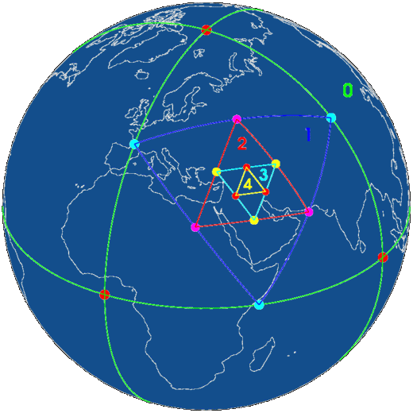
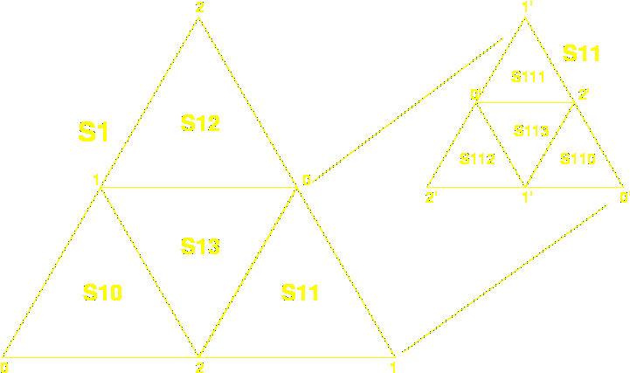
HTM: Hierarchical Triangular Mesh
HTM: www.sdss.jhu.edu/htm/
Invented at Johns Hopkins University for the SDSS survey.
The total Nr of pixels (trixels) in a map is set by depth:
d ∈ [0 , 25] (up to 30 possible!) N_{pix} = 8 ⋅ 4^{d}
ID_{range}: [N_{pix} , 2 ⋅ N_{pix} − 1]
Max res.: 9.0 ⋅ 10¹⁵ px → 7.7'' ⋅ 10⁻³ (24 cm on Earth)
RDBMS: an astronomical view. LN @ INAF - OAS Bologna

Slide 54
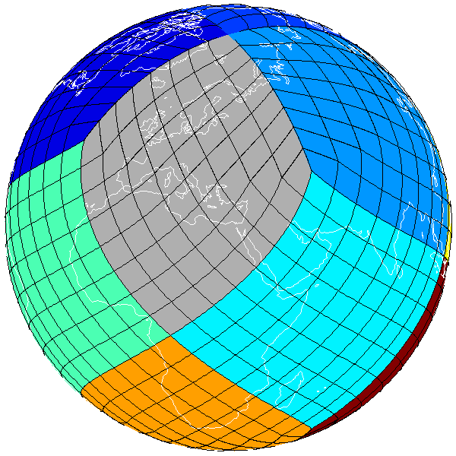
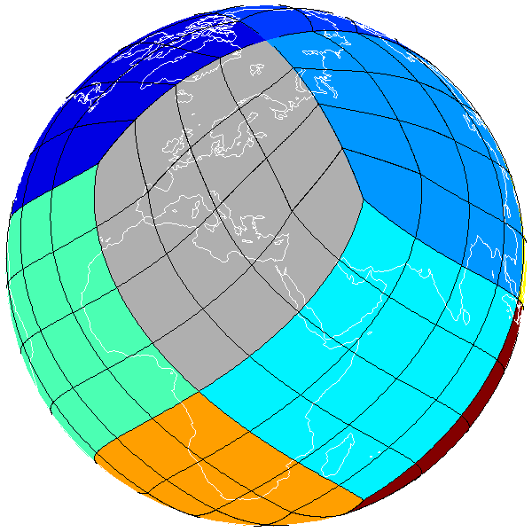
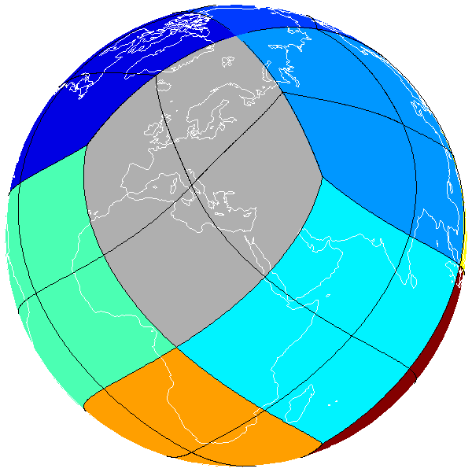
HEALPix: Hierarchical Equal Area isoLatitude Pixelization
k=3
k=2
k=1
HEALPix: healpix.jpl.nasa.gov
Invented at ESO for COBE. Also used by WMAP, Planck, etc.
The total Nr of pixels in a map is set by order: k ∈ [0 , 29]
N_{side} = 2^{k} N_{pix} = 12 ⋅ N²_{side}
ID_{range}: [0 , N_{pix} – 1] Ω_{pix} = π / (3 × N²_{side})
Max res.: 3.46 ⋅ 10¹⁸ pix → 3.93'' ⋅ 10⁻⁴ (1.2 cm on Earth)
RDBMS: an astronomical view. LN @ INAF - OAS Bologna

Slide 55
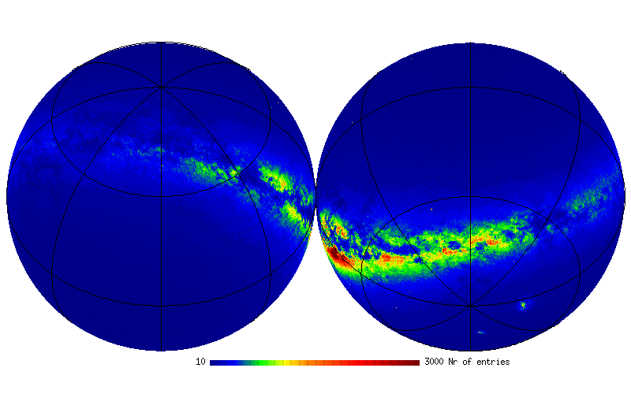
UCAC 4: sky objects density
N_{obj} = 113,780,000
K = 8 N_{pix}= 786,432
Ω_{pix} ~ 14’
Orthographic Equatorial
10
3000
RDBMS: an astronomical view. LN @ INAF - OAS Bologna
Notes:
Sky ojects

Slide 56
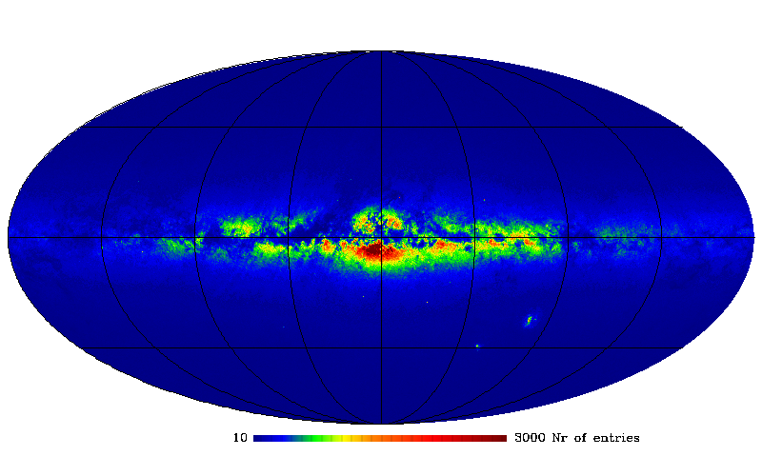
UCAC 4: sky objects density
N_{obj} = 113,780,000
K = 8 N_{pix}= 786,432
Ω_{pix} ~ 14’
Mollweide Galactic
10
3000
RDBMS: an astronomical view. LN @ INAF - OAS Bologna
Notes:
Sky ojects

Slide 57
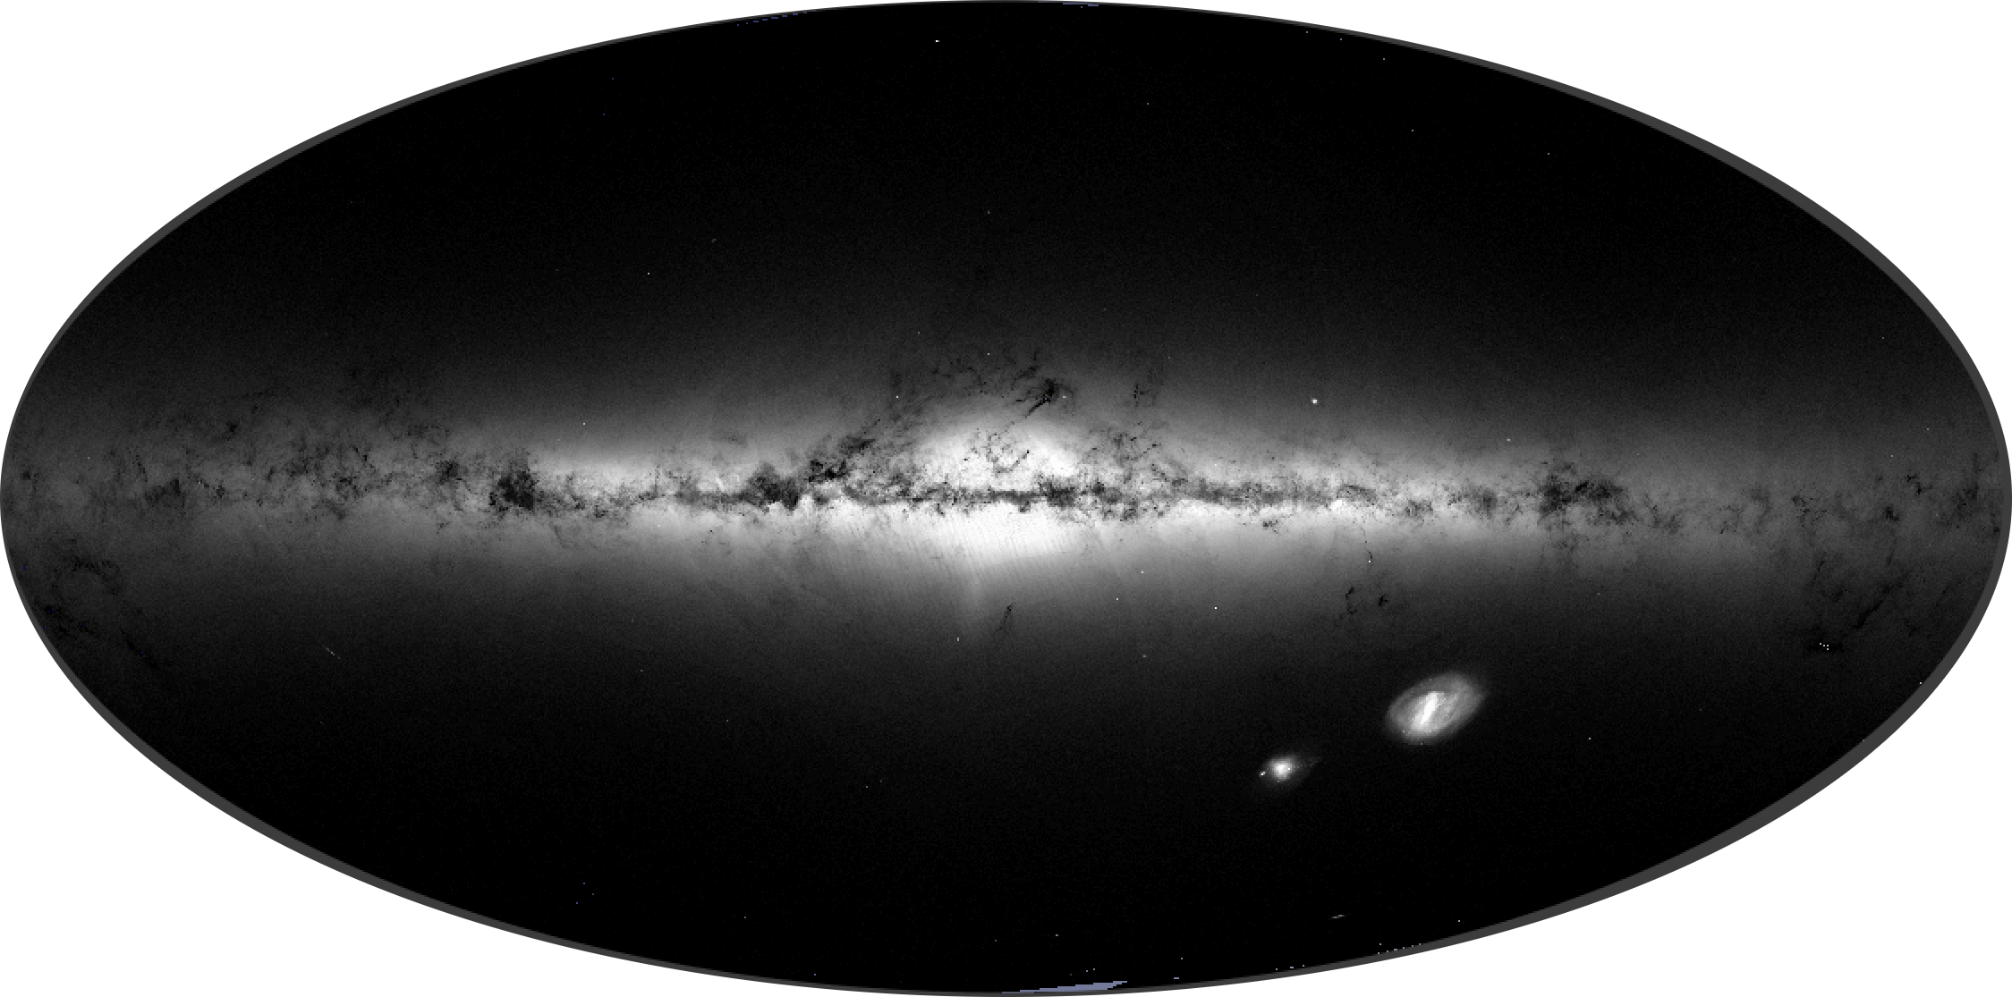
Gaia DR2: sky objects density
N_{obj} = 1,692,919,135
K = 10 N_{pix}= 12,582,912
Ω_{pix} ~ 3.5’
Mollweide Galactic
RDBMS: an astronomical view. LN @ INAF - OAS Bologna
Notes:
Sky ojects

Slide 58
HTM and HEALPix facts
Typically used pixelization resolutions:
− HTM: 6, 8, 10, 12 − HEALPix: 6, 8, 10, 12
d / k | Npix | <Area> | Obj/pix | Bytes
6 | 32,768 | 1.26 deg² | 89,290 | 2
8 | 524,288 | 283 arcmin² | 5,580 | 3
10 | 8,388,608 | 18 arcmin² | 348 | 3
12 | 134,217,728 | 1 arcmin² | 21 | 4
HTM
6 | 49,152 | 0.84 deg² | 59,526 | 2
8 | 786,432 | 189 arcmin² | 3,720 | 3
10 | 12,582,912 | 12 arcmin² | 232 | 3
12 | 201,326,592 | 0.7 arcmin² | 14 | 4
HEALPix
For generic use, ~1000 Obj/Pix gives best performance
RDBMS: an astronomical view. LN @ INAF - OAS Bologna
Notes:
Sky ojects

Slide 59
DIF: dynamic indexing facility
(DIF indexed) StarCat table
DIF.dif table
… | RA | Decl | … | htmID_6
param | ID | full
DIF added field+index
Dynamically generated
JOIN
htmID_6 = ID
StarCat_htm_6 VIEW
… | RA | Decl | … | htmID_6
Examples:
SELECT * From StarCat_htm_6 Where DIF_Circle( 82.5,12.0, 6 );
SELECT HEALPLookup(0,8,RA,Decl)
From GSC23_htm_6 Where DIF_Rect(20.1,30.5,8);
Center (°) & radius (´)
RDBMS: an astronomical view. LN @ INAF - OAS Bologna

Slide 60
DIF: MySQL extension
UDF Functions:
Sphedist (R1 ,D1, R2, D2)
HTMLookup (d, RA, Dec)
HEALPLookup (s, k, RA, Dec)
HTMsNeighb (d1, ID_d2, d2)
DIF.getHTMDepth (db, tab)
DIF.getHEALPOrder (db, tab)
DIF.getHEALPNested (db, tab)
DIF.getRa (db, tab)
DIF.getDec (db, tab)
HTMBary (d, ID)
HTMBaryC (d, RA, Dec)
HTMBaryDist (d, ID, RA, Dec)
HTMNeighb (d, ID)
HTMNeighbC (d, RA, Dec)
HEALPBary (s, k, ID)
HEALPBaryC (s, k, RA, Dec)
HEALPBaryDist (s, k, ID, RA, Dec)
HEALPNeighb (s, k, ID)
HEALPNeighbC (s, k, RA, Dec)
HEALPBound (s, k, ID, step)
HEALPBoundC (s, k, RA, Dec, step)
HEALPMaxS (k)
DIF engine Functions:
DIF_Circle (RA, Dec, R)
DIF_Rect (RA, Dec, S1, S2)
DIF_RectV (RA1, Dec1, ...)
DIF_NeighbC (RA, Dec)
DIF_sNeighb (d1, ID_d2, d2)
DIF_setHTMDepth (d)
DIF_setHEALPOrder (s, k)
DIF_FineSearch (var)
DIF_Sphedist (RA1, Dec1, RA2, Dec2)
DIF_cpuTime(), DIF_clear()
Select HEALPLookup(1,8,RA,Dec) From Cat Where DIF_Rect(0,0,20);
RDBMS: an astronomical view. LN @ INAF - OAS Bologna

Slide 61
SID: MySQL extension
UDF Functions:
HTMLookup (d, RA, Dec)
HTMidByName (ID_Name)
HTMnameById (ID)
HTMBary (d, ID)
HTMBaryC (d, RA, Dec)
HTMBaryDist (d, ID, RA, Dec)
HTMNeighb (d, ID)
HTMsNeighb (d1, ID_d2, d2)
HTMNeighbC (d, RA, Dec)
HEALPLookup (s, k, RA, Dec)
HEALPMaxS (k)
HEALPBary (s, k, ID)
HEALPBaryC (s, k, RA, Dec)
HEALPBaryDist (s, k, ID, RA, Dec)
HEALPNeighb (s, k, ID)
HEALPNeighbC (s, k, RA, Dec)
HEALPBound (s, k, ID, step)
HEALPBoundC (s, k, RA, Dec, step)
Sphedist (R1 ,D1, R2, D2)
SID specific UDFs:
SIDCount (p, full)
SIDGetID (p, i, full)
SIDClear ()
SIDCircleHTM (RA, Dec, R)
SIDRectHTM (RA, Dec, S1, S2)
SIDRectvHTM (RA1, Dec1, ...)
SIDCircleHEALP (RA, Dec)
SIDRectHEALP (var)
SIDRectvHEALP (RA1, Dec1, RA2, Dec2)
RDBMS: an astronomical view. LN @ INAF - OAS Bologna

Slide 62
MySQL base commands – 1
Let’s se what we have
mysql> show databases;
Create a database
mysql> create database name;
Example
mysql> create database mpe2018db;
Move to that database
mysql> use database_name;
Example
mysql> use mpe2018db;
RDBMS: an astronomical view. LN @ INAF - OAS Bologna

Slide 63
MySQL base commands – 2
Create a table. In brackets [] “optional” parameters.
mysql> create [temporary] table [if not exists]
table_name [(create definitions)]
[table options] [selections commands];
Example
mysql> create table user (
Id int not null AUTO_INCREMENT,
User varchar(20) not null default 'none',
Subscribed datetime,
PRIMARY KEY (Id)
) engine=MyISAM;
Note AUTO_INCREMENT. At each insert the value of this field (Id) is increased by 1, independently from the inserted value.
RDBMS: an astronomical view. LN @ INAF - OAS Bologna

Slide 64
MySQL base commands – 3
Insert data in a table (strings and dates quoted !)
mysql> INSERT INTO table_name VALUES
(first_field_content, 'second field content', 'terzo campo', …), (…), …;
Ex. (note the first field always 0. Could be any.)
mysql> insert into users values
(0, 'John', '2017-10-17 17:04:00'),
(0, 'Mark', '2017-10-17 17:04:10'),
(0, 'Jane', '2017-10-17 17:04:20');
Inquire
mysql> SELECT * FROM users;
RDBMS: an astronomical view. LN @ INAF - OAS Bologna

Slide 65
MySQL base commands – 4
Replace data in a table
mysql> REPLACE INTO table_name VALUES
(first_field_content,' 'second field content', ‘third field, …);
Modify data
mysql> UPDATE table_name SET field1=value1, field2=value2, … [WHERE condition];
Delete data
mysql> DELETE FROM table_name [WHERE ()];
Remove a table
mysql> DROP TABLE table_name;
See course reference website: ross2.iasfbo.inaf.it/wp/imprs18/
RDBMS: an astronomical view. LN @ INAF - OAS Bologna

Slide 66
MySQL base commands – 5
mysql> ?
Note that all text commands must be first on line and end with ';’
? (\?) Synonym for `help'.
clear (\c) Clear the current input statement.
connect (\r) Reconnect to the server. Optional arguments are db and host.
delimiter (\d) Set statement delimiter.
edit (\e) Edit command with $EDITOR.
ego (\G) Send command to mysql server, display result vertically.
exit (\q) Exit mysql. Same as quit.
go (\g) Send command to mysql server.
help (\h) Display this help.
nopager (\n) Disable pager, print to stdout.
notee (\t) Don't write into outfile.
pager (\P) Set PAGER [to_pager]. Print the query results via PAGER.
print (\p) Print current command.
prompt (\R) Change your mysql prompt.
quit (\q) Quit mysql.rehash (\#) Rebuild completion hash.
source (\.) Execute an SQL script file. Takes a file name as an argument.
status (\s) Get status information from the server.
system (\!) Execute a system shell command.
tee (\T) Set outfile [to_outfile]. Append everything into given outfile.
use (\u) Use another database. Takes database name as argument.
charset (\C) Switch to another charset. Might be needed for processing binlog with ...
warnings (\W) Show warnings after every statement.
nowarning (\w) Don't show warnings after every statement.
resetconnection(\x) Clean session context.
For server side help, type 'help contents'
RDBMS: an astronomical view. LN @ INAF - OAS Bologna

Slide 67
MySQL base commands – 6
mysql> help contents;
For more information, type 'help <item>', where <item> is one of the following categories:
Account Management
Administration
Compound Statements
Data Definition
Data Manipulation
Data Types
Functions
Functions and Modifiers for Use with GROUP BY
Geographic Features
Help Metadata
Language Structure
Plugins
Procedures
Storage Engines
Table Maintenance
Transactions
User-Defined Functions
Utility
RDBMS: an astronomical view. LN @ INAF - OAS Bologna

Slide 68
MySQL base commands: suggestions
Use descriptive names that reflect the subject of the table or/and the data;
Do not use specific names for data that could assume generic values;
Avoid abbreviations and acronyms;
Do not use punctuation or blanks in the names;
Use plural for table names and singular for field names;
Relational tables typically have a name that is a combination of the names of the joined tables.
Note 1: all the commands and field names are case Insensitive.
Note 2: DB names and table names “could” be Sensitive, depending on the Operative System and the server configuration.
RDBMS: an astronomical view. LN @ INAF - OAS Bologna

Slide 69
The Messier table creation – 1
If DIF installed
Here we use the MySQL client command to connect to the MySQL server. Use user “root” for convenience.
mysql --local-infile=1 -u root –p [ DIF ]
Enter password:
mysql> USE DIF;
mysql> SHOW TABLES;
+---------------+
| Tables_in_dif |
+---------------+
| Messier |
| TypeDescr |
| dif |
| tbl |
+---------------+
RDBMS: an astronomical view. LN @ INAF - OAS Bologna

Slide 70
The Messier table creation – 2
In the working DB, drop table if already there, then create it.
USE mpe2018db;
DROP TABLE IF EXISTS Messier;
CREATE TABLE Messier (
M int NOT NULL,
Type CHAR(2) DEFAULT '**',
Const CHAR(3) DEFAULT '***',
Mag FLOAT,
Ra FLOAT,
Decl FLOAT,
Dist CHAR(20),
App_size CHAR(20) DEFAULT 'unknown',
PRIMARY KEY(M), INDEX(Type)
) engine=MyISAM;
RDBMS: an astronomical view. LN @ INAF - OAS Bologna

Slide 71
The Messier table creation – 3
Read from an ASCII file using LOAD DATA INFILE.
LOAD DATA LOCAL INFILE './messier.tsv'
INTO TABLE Messier;
[ SELECT * FROM Messier; ]
UPDATE Messier SET Ra = Ra * 15.0;
[ SELECT * FROM Messier; ]
Also create an object type code table.
CREATE TABLE TypeDescr(
Type CHAR(2), Descr CHAR(20),
PRIMARY KEY(Type)
);
LOAD DATA LOCAL INFILE './messier_legend.tsv'
INTO TABLE TypeDescr;
RDBMS: an astronomical view. LN @ INAF - OAS Bologna

Slide 72
The Messier table creation – 4
The “legend” ASCII file load into TypeDescr.
OC Open Cluster
GC Globular Cluster
GX Galaxy
PN Planetary Nebula
BN Bright Nebula
DN Dark Nebula
*2 Double Star
*C Star Cloud
Note that the default field separator is the (invisible) <Tab> (\t) and the end line character is <NewLine> (\n).
Can use any separator/terminator using the FIELDS/LINES TERMINATED BY clause. More can be given.
\t
\n
RDBMS: an astronomical view. LN @ INAF - OAS Bologna

Slide 73
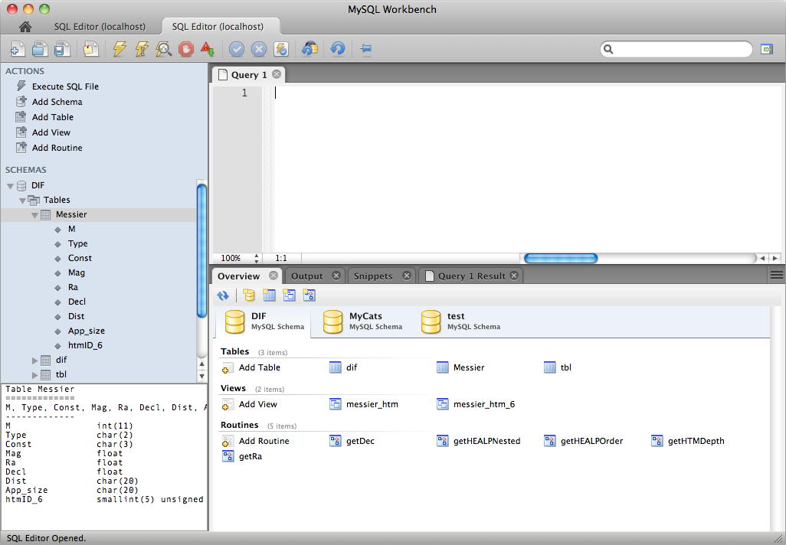
Messier catalogue example – 1
Data + metadata + software = DATABASE !
database
tables
views
routines
RDBMS: an astronomical view. LN @ INAF - OAS Bologna

Slide 74
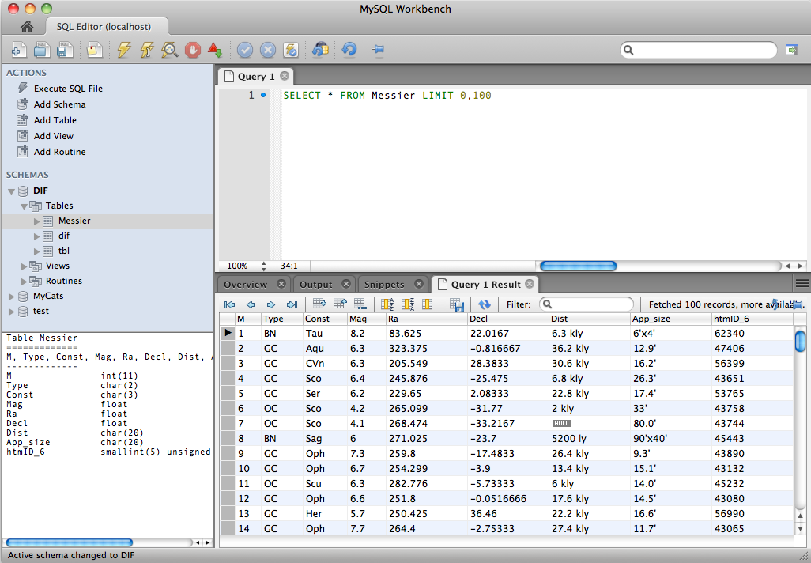
Messier catalogue example – 2
NULL value.
Not 0 or blank!
Field, column,
attribute
Row, entry,
observation, tuple
RDBMS: an astronomical view. LN @ INAF - OAS Bologna

Slide 75
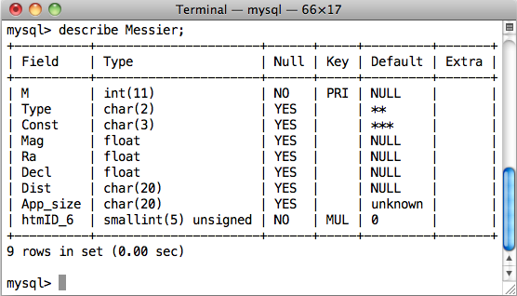
The Messier table structure
Must know what type of query can be performed on the fields.
Data Type
Default value
Primary Key
Foreign Key
RDBMS: an astronomical view. LN @ INAF - OAS Bologna

Slide 76
How to query a database – 1
Server based DBs require connection and authentication;
then you can start querying using the SQL.
Via command line tool.
Type your query (command) at the prompt and see the output.
Via dedicated GUI interface.
Also allows DB management.
Via custom applications using API libraries.
Transfer data from/to your software program.
ODBC (Open DB Connectivity) drivers ➔ translation layer between applications and DBMS.
Can use (almost) any programming language to query a DBMS.
RDBMS: an astronomical view. LN @ INAF - OAS Bologna

Slide 77
How to query a database – 2
DBMS
_ o x
A
B
C
Your query output
C1 C2 C3 …
GUI
_ o x
$ mysql –u me –ppass myDB –e “select c1, c2, c5 from myTab where c4 <= 0”
$ mysql –u me –p myDB
mysql> SELECT *
FROM my_table
WHERE c3 > 10;
DBConn db;
db.connect(usr,pass,db,host);
Query qry(&db);
qry.query(“SELECT * FROM my_table WHERE c3 > 10”);
database
Shell
Program
RDBMS: an astronomical view. LN @ INAF - OAS Bologna

Slide 78
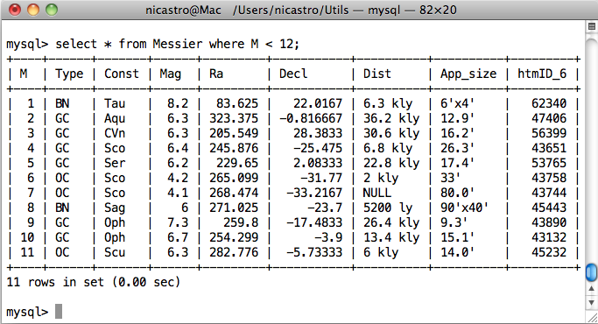
How to query a database – 3
Via terminal (MySQL monitor / client).
RDBMS: an astronomical view. LN @ INAF - OAS Bologna

Slide 79
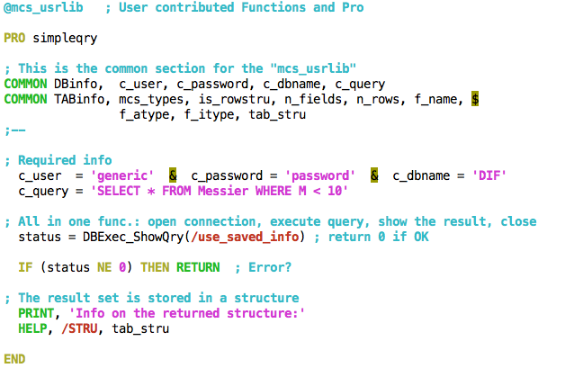
How to query a database – 4
Via custom applications using API libraries. Here IDL (custom).
RDBMS: an astronomical view. LN @ INAF - OAS Bologna

Slide 80
SQL: Structured Query Language
Can also be used to build scripts, functions, procedures.
Most common query statements: SELECT, INSERT, DELETE, UPDATE.
Note: INSERT, DELETE are “record-based” operations.
Implemented for the first time in 1970 (with the name SEQUEL, (Structured English Query Language) for the IBM “System R”.
Adopted as standard ANSI (1986) and ISO (1987) with the name of SQL (pronounced “ES-Q-EL”);
There exist various versions:
SQL-86, SQL-87 (adopted by ISO)
SQL-89
SQL-92 (the most commonly used)
SQL-99 (addition of regular expressions, subqueries, triggers, etc.)
SQL-2003 (XML and other advanced functionalities. Not free!
SQL-2016
RDBMS: an astronomical view. LN @ INAF - OAS Bologna

Slide 81
SQL extensions and DB servers
Each DB server implements it’s own extensions. Some are generally available, other are very specific. Relational DB servers commonly used include: Oracle, Sybase, SQLServer, DB2, MySQL, PostgreSQL, SQLite, …
We have used (and will use) MySQL (or MariaDB) as a reference. It is open source and runs on Linux, MacOS, Windows, Solaris, HPUX.
Pre-compiled installations are very simple to install. Here we’ll show the source code installation procedure. I suggest you try it yourself. I can help in case of troubles. Just remember to create the “root” account. It is used for all the management aspects related to the DB server.
SQLite is a zero-configuration DB ➔ no client/server architecture.
Can be used to manage Application Files. Rather than using fopen() to write XML or some proprietary format into disk files used by your application, use an SQLite database instead. You'll avoid having to write and troubleshoot a parser, your data will be more easily accessible and cross-platform, and your updates will be transactional.
RDBMS: an astronomical view. LN @ INAF - OAS Bologna

Slide 82
SQL: the language Statements
DDL: is abbreviation of Data Definition Language.
It is used to create and modify the DB structure or schema. Examples: CREATE, ALTER, DROP.
DML: abbreviation of Data Manipulation Language.
It is used for managing data within schema objects, e.g. retrieve, store, modify, delete, insert and update data. Examples: SELECT, UPDATE, INSERT.
DCL: is abbreviation of Data Control Language.
It is used to create roles, permissions, and referential integrity as well as to control access to database by securing it. Examples: GRANT, REVOKE.
TCL: is abbreviation of Transactional Control Language.
It is used to manage different transactions occurring within a database. Examples: COMMIT, ROLLBACK.
RDBMS: an astronomical view. LN @ INAF - OAS Bologna

Slide 83
DDL: Data Definition Language – 1
It’s the set of SQL instructions to define the structure of the DB.
Create and modify the structure of database objects:
CREATE – create objects (DB,s tables, indices, views, etc.) in the database
ALTER – alter the structure of a table or other objects of the DB
DROP – delete objects from the database, e.g. a table
TRUNCATE – remove all records from a table, including all spaces allocated for the records are removed
COMMENT – add comments to the data dictionary
RENAME – rename an object
RDBMS: an astronomical view. LN @ INAF - OAS Bologna

Slide 84
DDL: Data Definition Language – 2
To define a table means to define attributes and their domain.
Domains are those typical of each programming language:
– integer numbers (int, integer, decimal)
– floating point numbers (float, real, double)
– character strings (char, varchar, text)
– dates (date, time, timestamp, year, datetime)
Other types can be defined on the basis of specific capabilities of a certain RDBMS.
Each attribute can be also characterized by a default value and a number of constraints (e.g. “not null” for mandatory value fields in a table).
Among the constraints there is the possibility to add an attribute to the primary key of the table or use the attribute of external key referencing one or more key fields of another table.
RDBMS: an astronomical view. LN @ INAF - OAS Bologna

Slide 85
DDL: Data Definition Language – 3
Examples:
create database mpe2018db;
drop database mpe2018db;
create table Messier_new like Messier;
create table TestCat select * from Messier;
alter table Messier set RA = RA*15.;
alter table Messier add column htmID_6 SMALLINT UNSIGNED, add index pos (htmID_6, RA);
drop table TestCat;
truncate table TestCat;
rename table Messier to Messier_new;
RDBMS: an astronomical view. LN @ INAF - OAS Bologna

Slide 86
DML: Data Manipulation Language – 1
It’s the set of SQL instructions to manipulate data/information within a DB. The main instructions are:
SELECT – retrieve data from one or more tables in a DB
INSERT – insert data into a table
UPDATE – update existing data within a table
DELETE – delete records from a table, the space for the records remain
CALL – call a SQL or (other language) subprogram
LOCK TABLE – control concurrency
REPLACE/MERGE, DO, HANDLER, LOAD DATA INFILE
…
RDBMS: an astronomical view. LN @ INAF - OAS Bologna

Slide 87
DML: Data Manipulation Language – 2
Prepared Statements:
PREPARE, EXECUTE, DEALLOCATE PREPARE
Compound-statements:
BEGIN … END, DECLARE, SELECT … INTO
Cursors:
OPEN, FETCH, CLOSE
Flow Control Constructs:
IF, CASE, LOOP, LEAVE, ITERATE, REPEAT, WHILE
RETURN
RDBMS: an astronomical view. LN @ INAF - OAS Bologna

Slide 88
DCL: Administration Statements – 1
Set of SQL instructions for the database/tables access privileges definition and the management of the user accounts.
The main DCL instructions are two:
grant: to assign permissions to a user
revoke: to revoke a certain privileges to a user
Assigning privileges:
grant privileges on resources to user [[with grant option];
Example:
grant select on courses to mpeusr@localhost;
RDBMS: an astronomical view. LN @ INAF - OAS Bologna

Slide 89
DCL: Administration Statements – 2
Account management: users, permissions, view status, etc.
CREATE USER, DROP USER, RENAME USER, GRANT, REVOKE, SET PASSWORD, e.g.
GRANT – gives user's access privileges to database
REVOKE – withdraw access privileges given with the GRANT command
Table maintenance:
ANALYSE TABLE, CHECK TABLE, REPAIR TABLE
Plugin and User-Defined Function Statements:
CREATE/DROP FUNCTION, INSTALL/UNINSTALL PLUGIN
RDBMS: an astronomical view. LN @ INAF - OAS Bologna

Slide 90
SQL: Utility Statements and common clauses
View status, etc.:
SET, SHOW, DESCRIBE ( SHOW COLUMNS FROM ), EXPLAIN, HELP, USE, FLUSH, KILL, RESET, e.g.
SHOW item – provide information about a long list of things: databases, tables, view, columns, functions, status, about the server, …
EXPLAIN item – explain query execution, access path to data, e.g.
EXPLAIN SELECT the_Query;
Common SELECT clauses:
LIMIT, HAVING, GROUP BY, ORDER BY, INTO OUTFILE, BETWEEN, IN
Aggregation
RDBMS: an astronomical view. LN @ INAF - OAS Bologna

Slide 91
SQL: Functions and Operators – 1
Most of them are SQL standard, other are specific to each DB server. Below those for MySQL.
Operators (with Type Conversion in Expression Evaluation)
Control Flow Functions ( IF(), CASE )
String Functions, Numeric Functions and Operators
Date and Time Functions
Full-Text Search Functions
Cast Functions and Operators
XML Functions
Bit Functions
Encryption and Compression Functions
…continue…
RDBMS: an astronomical view. LN @ INAF - OAS Bologna

Slide 92
SQL: Functions and Operators – 2
…continued
Information / miscellaneous Functions
Functions and Modifiers for Use with GROUP BY Clauses
Spatial Extensions (2-d)
Precision Math
Example:
COUNT, MIN, MAX, SUM, AVG, STDDEV
Note:
All commands and column names are case insensitive.
DB names and Table names “can” be case sensitive, depending on OS and configuration of the server.
Aggregation
RDBMS: an astronomical view. LN @ INAF - OAS Bologna

Slide 93
The importance of indexing – 1
Except for small tables and for table which will need to be ready (almost) at every query, you must always index the table on one or more columns, either as a compound single index or with multiple indices.
There are various types of index (or key):
Primary key
Unique key (superkey, compound key, composite key, alternate key)
Multiple key (foreign key)
Note:
Generally a key can be the combination of more columns.
Keys have several constraints.
The foreign key identifies 1 or more columns in one (referencing) table that refers to a set of columns in another (referenced) table. The columns in the referencing table must be the primary key or other candidate key in the referenced table.
RDBMS: an astronomical view. LN @ INAF - OAS Bologna

Slide 94
The importance of indexing – 2
Primary key constraints:
A set of attributes is a key for a relation if:
No two distinct rows can have the same values in all key fields.
A proper subset of the key attributes is not a key.
Superkey:
It is a set of attributes within a table whose values can be used to uniquely identify a tuple.
A proper subset of a superkey may be a superkey.
If multiple keys, one of them is chosen to be the primary key.
e.g.: PRIMARY KEY (StarCat) = <StarID>
RDBMS: an astronomical view. LN @ INAF - OAS Bologna

Slide 95
The importance of indexing – 3
Candidate keys (SQL: Unique):
Keys that are not primary keys are candidate keys.
Specified in SQL using UNIQUE.
Attribute of unique key may have NULL values !
E.g.: StarCat (starID, coordID)
PRIMARY KEY (StarCat) = <starID>
CANDIDATE KEY (StarCat) = <coordID>
RDBMS: an astronomical view. LN @ INAF - OAS Bologna

Slide 96
The importance of indexing – 4
Keys are fundamental for relational operations → JOIN
Example: star clusters in the Messier catalogue:
SELECT Messier.*, TypeDescr.Descr
FROM Messier LEFT JOIN TypeDescr
ON Messier.Type = TypeDescr.Type
WHERE TypeDescr.Descr LIKE '%cluster%';
RDBMS: an astronomical view. LN @ INAF - OAS Bologna

Slide 97
Back to Messier: let’s use indexing
If a query does not use an indexed column, then the entire table has be scanned ➔ no help!
Indexing examples:
ALTER TABLE Messier ADD UNIQUE KEY (M);
ALTER TABLE Messier ADD INDEX (Type);
ALTER TABLE Messier ADD INDEX pos(htmID_6,Ra);
To show the indices:
SHOW INDEX FROM Messier;
The field to look at is Cardinality: it tells how many distinct rows that index points to in the table. The cardinality of PRIMARY / UNIQUE keys is exactly the number of rows in the table, i.e. each key points to a single entry. Each multiple key refers to N_rows / Cardinality, i.e. it gives the table grouping factor.
RDBMS: an astronomical view. LN @ INAF - OAS Bologna

Slide 98
Example queries using indices
SELECT Ra, Decl, Mag FROM Messier WHERE M=33;
SELECT M, App_size FROM Messier WHERE M BETWEEN 10 AND 13;
SELECT COUNT(*) FROM Messier WHERE Type = 'GC';
SELECT COUNT(Mag) AS N, AVG(Mag) AS Mag_ave
FROM Messier WHERE Type = 'PN';
SELECT COUNT(*) AS N, ROUND(AVG(Mag)) AS IMag_ave
FROM Messier WHERE Type = 'GX' AND Decl > 0;
RDBMS: an astronomical view. LN @ INAF - OAS Bologna

Slide 99
A simple JOIN
SELECT Messier.M, Messier.Type, Messier.App_size, Messier.Const, TypeDescr.Descr
FROM Messier LEFT JOIN TypeDescr
ON Messier.Type = TypeDescr.Type LIMIT 5;
+---+------+----------+-------+------------------+
| M | Type | App_size | Const | Descr |
+---+------+----------+-------+------------------+
| 1 | BN | 6'x4' | Tau | Bright Nebula |
| 2 | GC | 12.9' | Aqu | Globular Cluster |
| 3 | GC | 16.2' | CVn | Globular Cluster |
| 4 | GC | 26.3' | Sco | Globular Cluster |
| 5 | GC | 17.4' | Ser | Globular Cluster |
+---+------+----------+-------+------------------+
Selections on sky regions?
See SID or DIF package.
RDBMS: an astronomical view. LN @ INAF - OAS Bologna

Slide 100
Prepared statements
It’s a flexible way to reuse statements several times
It’s an optimised way to insert data: INSERT prepared once, executed multiple times
Operations are (mostly) performed server-side
Used through client programming interfaces
Possible also in SQL scripts
It’s a 3 steps operation:
PREPARE the query with ? as parameters placeholder (not always)
EXECUTE the query passing the parameters value
DEALLOCATE PREPARE
RDBMS: an astronomical view. LN @ INAF - OAS Bologna

Slide 101
Prepared statements
INSERT SQL example:
CREATE TABLE mystars (
ID int not null, RA double, DE double, Mag float);
PREPARE stmt FROM 'INSERT INTO mystars VALUES (?, ?, ?, ?)’;
SET @id = 1; SET @mag = 13.26;
SET @ra = 67.2345; SET @de = -36.12;
EXECUTE stmt USING @id, @ra, @de, @mag;
SET @id = 2; SET @mag = 12.33;
SET @ra = 127.543; SET @de = -12.68;
EXECUTE stmt USING @id, @ra, @de, @mag;
DEALLOCATE PREPARE stmt;
https://dev.mysql.com/doc/refman/5.7/en/sql-syntax-prepared-statements.html
RDBMS: an astronomical view. LN @ INAF - OAS Bologna

Slide 102
SQL functions / procedures – 1
DELIMITER //
DROP FUNCTION IF EXISTS skydist//
CREATE FUNCTION skydist(a1 DOUBLE, b1 DOUBLE, a2 DOUBLE,b2 DOUBLE)
RETURNS DOUBLE
BEGIN
DECLARE d2r, a1r, b1r, a2r, b2r, radiff, cosdis, dist DOUBLE;
SET d2r = 0.017453292519943;
SET a1r = a1*d2r; SET b1r = b1*d2r;
SET a2r = a2*d2r; SET b2r = b2*d2r;
SET radiff = ABS(a2r-a1r);
IF (radiff > pi()) THEN
SET radiff = 2e0 * pi() - radiff;
END IF;
SET cosdis = sin(b1r)*sin(b2r) + cos(b1r)*cos(b2r)*cos(radiff);
SET dist = acos(cosdis)/d2r;
RETURN dist; -- distance in Degrees
END//
delimiter ;
RDBMS: an astronomical view. LN @ INAF - OAS Bologna

Slide 103
SQL functions / procedures – 2
SELECT skydist(170.2, 32.4, 171, 33) AS dist_deg;
+-------------------+
| dist_deg |
+-------------------+
| 0.901775161467635 |
+-------------------+
SELECT skydist(Ra, Decl, 83, 22)*60 AS dist_arcmin
FROM Messier WHERE M=1;
+-------------------+
| dist_arcmin |
+-------------------+
| 34.78175964005546 |
+-------------------+
RDBMS: an astronomical view. LN @ INAF - OAS Bologna

Slide 104
SQL functions / procedures – 3
SET @ra1=0, @de1=0;
SELECT Ra, Decl INTO @ra1, @de1 FROM Messier WHERE M=1;
SELECT M, skydist(Ra, Decl, @ra1, @de1) AS dist_deg
FROM Messier WHERE M>1 AND M<5;
+---+--------------------+
| M | dist_deg |
+---+--------------------+
| 2 | 118.1862068372224 |
| 3 | 104.66108688957472 |
| 4 | 163.40339738779477 |
+---+--------------------+
SELECT M, Type, skydist(Ra, Decl, @ra1, @de1)*60 AS dist_arcmin
FROM Messier HAVING dist_arcmin < 500;
+----+------+------------------+
| M | Type | dist_arcmin |
+----+------+------------------+
| 1 | BN | 0 |
| 35 | OC | 495.768345080102 |
+----+------+------------------+
RDBMS: an astronomical view. LN @ INAF - OAS Bologna

Slide 105
SQL functions / procedures – 4
DROP PROCEDURE IF EXISTS hadec2altaz;
DELIMITER //
CREATE PROCEDURE hadec2altaz(IN ha DOUBLE, IN decl DOUBLE, IN lat DOUBLE, OUT alt DOUBLE, OUT az DOUBLE)
DETERMINISTIC
BEGIN
DECLARE d2r, sh, ch, sd, cd, sl, cl DOUBLE;
DECLARE x, y, z, r DOUBLE;
SET d2r = pi()/180.0;
SET sh = sin(ha*d2r); SET ch = cos(ha*d2r);
SET sd = sin(decl*d2r); SET cd = cos(decl*d2r);
SET sl = sin(lat*d2r); SET cl = cos(lat*d2r);
SET x = - ch * cd * sl + sd * cl; SET y = - sh * cd;
SET z = ch * cd * cl + sd * sl; SET r = sqrt(x*x + y*y);
SET az = atan(y,x) / d2r; SET alt = atan(z,r) / d2r;
IF (az < 0) THEN
SET az = az + 360;
END IF;
END//
delimiter ;
RDBMS: an astronomical view. LN @ INAF - OAS Bologna

Slide 106
SQL functions / procedures – 5
CALL hadec2altaz(270, 46, 44, @alt, @az);
SELECT @alt, @az;
+------------------+------------------+
| @alt | @az |
+------------------+------------------+
| 29.9798507651043 | 53.3176415064057 |
+------------------+------------------+
CALL hadec2altaz(180, 46, 44, @alt, @az);
+-----------------------+------+
| @alt | @az |
+-----------------------+------+
| -6.36110936292703e-15 | 360 |
+-----------------------+------+
SELECT * FROM INFORMATION_SCHEMA.ROUTINES WHERE routine_name like 'sky%';
See more functions / procedures in the Soft/SQL folder of the course.
RDBMS: an astronomical view. LN @ INAF - OAS Bologna

Slide 107
Aggregating – 1
SELECT propID, object, pi_coi, filter, exptime,
COUNT(exptime) as Nobs, SUM(exptime) as TotExp,
DATE(date_obs) as Day
FROM Obslog WHERE date_obs>'2011-04-16 22:00:00' AND
date_obs<'2011-04-17 12:00:00’
GROUP BY propid, object, pi_coi, filter, exptime
propID object pi_coi filter exptime Nobs TotExp Day
------ ------------- ------------- ------- -------- ------ ------- ----------
5 SA098_978 REM_Team GRI 5 7 35 2011-04-16
5 SA098_978 REM_Team H 5 7 35 2011-04-16
5 SA098_978 REM_Team I 20 8 160 2011-04-16
5 SA098_978 REM_Team J 5 7 35 2011-04-16
23007 sdss15724 Elena_Pancino R 180 3 540 2011-04-17
23007 sdss15724 Elena_Pancino J 20 63 1260 2011-04-17
23038 DP_Cru Marcio_Catelan K 10 7 70 2011-04-17
23038 DP_Cru Marcio_Catelan V 5 1 5 2011-04-17
…
RDBMS: an astronomical view. LN @ INAF - OAS Bologna

Slide 108
Aggregating – 2
SELECT propID, COUNT(exptime) AS Nobs, SUM(exptime) AS TotExp
FROM Obslog WHERE date_obs>'2011-04-16 22:00:00' AND
date_obs<'2011-04-17 12:00:00’
GROUP BY propID ORDER BY TotExp [ ASC | DESC ];
| propID | Nobs | TotExp |
+--------+------+--------+
| 23071 | 24 | 24 |
| 7 | 11 | 55 |
| 5 | 59 | 655 |
| 23012 | 30 | 960 |
| 23062 | 22 | 1470 |
| 23073 | 24 | 1530 |
| 23030 | 87 | 1722 |
| 23735 | 120 | 2120 |
| 23038 | 120 | 2475 |
| 23007 | 72 | 2880 |
| 23027 | 117 | 3510 |
| 23011 | 196 | 5880 |
| 23047 | 210 | 6300 |
RDBMS: an astronomical view. LN @ INAF - OAS Bologna

Slide 109
Views – 1
DROP VIEW IF EXISTS Messier_view;
CREATE VIEW Messier_view AS
SELECT Messier.M,
TypeDescr.Descr AS Descr,
Messier.Const,
Messier.Mag,
Messier.Ra,
Messier.Decl,
ROUND( radec2alt(Messier.Ra, Messier.Decl, 44.5, 11.3, -1,
now()), 2 ) AS Alt,
ROUND( radec2az( Messier.Ra, Messier.Decl, 44.5, 11.3, -1,
now()), 2 ) AS Az,
Messier.Dist,
Messier.App_size
FROM Messier LEFT JOIN TypeDescr
ON Messier.Type = TypeDescr.Type
ORDER BY Descr, M;
RDBMS: an astronomical view. LN @ INAF - OAS Bologna

Slide 110
Views – 2
DESCRIBE Messier_view;
+----------+----------+------+-----+---------+-------+
| Field | Type | Null | Key | Default | Extra |
+----------+----------+------+-----+---------+-------+
| M | int(11) | NO | | NULL | |
| Descr | char(20) | YES | | NULL | |
| Const | char(3) | YES | | *** | |
| Mag | float | YES | | NULL | |
| Ra | float | YES | | NULL | |
| Decl | float | YES | | NULL | |
| Alt | double | YES | | NULL | |
| Az | double | YES | | NULL | |
| Dist | char(20) | YES | | NULL | |
| App_size | char(20) | YES | | unknown | |
+----------+----------+------+-----+---------+-------+
RDBMS: an astronomical view. LN @ INAF - OAS Bologna

Slide 111
Views – 3
SELECT * FROM Messier_view limit 4;
+----+---------------+-------+------+---------+----------+-------+--------+---------+----------+
| M | Descr | Const | Mag | Ra | Decl | Alt | Az | Dist | App_size |
+----+---------------+-------+------+---------+----------+-------+--------+---------+----------+
| 73 | NULL | Aqu | 9 | 20.9817 | -11.365 | 8.01 | 245.33 | -- | 2.8' |
| 1 | Bright Nebula | Tau | 8.2 | 5.575 | 22.0167 | 20.77 | 280.92 | 6.3 kly | 6'x4' |
| 8 | Bright Nebula | Sag | 6 | 18.0683 | -23.7 | -3.06 | 239.21 | 5200 ly | 90'x40' |
| 17 | Bright Nebula | Sag | 7.5 | 18.345 | -15.8333 | 2.97 | 244.27 | 5000 ly | 11.0' |
+----+---------------+-------+------+---------+----------+-------+--------+---------+----------+
RDBMS: an astronomical view. LN @ INAF - OAS Bologna

Slide 112
How to insert data files into a DB
For ASCII (text) files several methods are available within the various DB servers. A lot of external tools also exist. XML files are also managed automatically by MySQL:
LOAD DATA [LOCAL] INFILE 'data.txt' INTO TABLE db.my_table;
LOAD XML INFILE 'data.xml' INTO TABLE db.my_table
[ROWS IDENTIFIED BY ‘<tagname>'];
VOTables: either considered as XML or using custom programs (see examples)
For FITS files can use custom programs, see e.g. Julia or MCS.
It is easy to write simple programs to import into DBs binary files. See examples and use case exercises in the course.
RDBMS: an astronomical view. LN @ INAF - OAS Bologna

Slide 113
How to export data from one DB to another
There are many possibilities, depending if a full table has to be exported or just a subset:
Direct transfer: INSERT INTO DB2.tab1 SELECT * FROM DB1.tab1
Export to file, e.g. from shell: mysql -u usr -p --xml -e “select * from mytable” mydb > file.xml
If different server are involved then it depends on the size of the data to export. It is possible to proceed as follows:
On server A export to a file the data and then restore them on the server B, e.g. from shell: mysqldump –u root –p DBName TableName
From server B perform the query on server A and store/save the data (all at once or in chunks) into a local file or directly into the DB table, e.g. SELECT * FROM Table INTO OUTFILE ‘/path/to/file.tsv’;
Simply copy the DB disk files from server A into the DB disk on server B (a DB = directory, a table = one or more files).
Write a program that connects to the two DBs (read from A write to B).
RDBMS: an astronomical view. LN @ INAF - OAS Bologna

Slide 114
Import/export examples: SQL
LOAD DATA INFILE 'mydata.txt' INTO TABLE mytable (col1,col2,...);
LOAD DATA LOCAL INFILE 'data.csv' INTO TABLE tbl_name
FIELDS TERMINATED BY ',' OPTIONALLY ENCLOSED BY '"'
LINES TERMINATED BY '\r\n'
IGNORE 1 LINES;
LOAD DATA LOCAL INFILE 'file.tsv'
INTO TABLE t1
(column1, @var1)
SET column2 = @var1/100;
LOAD DATA LOCAL INFILE 'file.tsv'
INTO TABLE t1
(column1, column2)
SET column3 = CURRENT_TIMESTAMP;
RDBMS: an astronomical view. LN @ INAF - OAS Bologna

Slide 115
Import/export examples: SQL
Direct transfer:
INSERT INTO DB2.tab1 SELECT * FROM DB1.tab1
INSERT INTO DB2.tab1 SELECT * FROM DB1.tab2 WHERE c1 BETWEEN 1 AND 100;
Saving data into an ASCII file:
SELECT * FROM Table INTO OUTFILE ‘/path/out_file.tsv’;
SELECT c1,c3,c4,c6/10 FROM Table INTO OUTFILE ‘/path/out_file.tsv’;
…
Note 1: must give full path and the output directory must be writeable to the user mysql. So you either from the shell you do a preliminary “chmod o+w out_dir”, or use a directory writeable to all, like /tmp
Note 2: the output directory could be predefined by your MySQL installation. In this case you could be forced to use just that directory.
RDBMS: an astronomical view. LN @ INAF - OAS Bologna

Slide 116
Import/export examples: shell commands
mysql -u root -p --xml -e “select * from mydb.mytable” > file.xml
mysqldump –u root -p DBName TableName
mysql -u root -p --html -e “select * from mydb.mytable” > file.html
…
For MyISAM tables, simply copy the DB disk files from server A into the DB disk on server B (a DB = directory, a table = one or more files):
scp /usr/local/mysql/data/test/simpleBSC* usr@host:/dest/db
Note: any user with SELECT permission can issue these commands, not just root.
RDBMS: an astronomical view. LN @ INAF - OAS Bologna

Slide 117
Import/export examples: custom programs
See example client programs in the various languages
RDBMS: an astronomical view. LN @ INAF - OAS Bologna

Slide 118
INFORMATION_SCHEMA database
INFORMATION_SCHEMA tables:
http://dev.mysql.com/doc/refman/5.7/en/information-schema.html
INFORMATION_SCHEMA index:
http://dev.mysql.com/doc/refman/5.7/en/dynindex-is.html
mysql> select * from information_schema.tables where table_name=‘ucac2_initial';
mysql> select * from information_schema.columns where table_name=‘ucac2_initial';
mysql> SELECT table_name FROM INFORMATION_SCHEMA.TABLES where table_schema='mpe2018db' AND table_type != 'View';
mysql> SELECT * FROM INFORMATION_SCHEMA.ROUTINES WHERE routine_name like 'sky%';
RDBMS: an astronomical view. LN @ INAF - OAS Bologna

Slide 119
User Defined Functions (UDFs)
See:
http://dev.mysql.com/doc/refman/5.7/en/adding-functions.html
http://dev.mysql.com/doc/refman/5.7/en/create-function-udf.html
CREATE [AGGREGATE] FUNCTION function_name RETURNS {STRING|INTEGER|REAL|DECIMAL}
SONAME shared_library_name;
DROP {PROCEDURE | FUNCTION} [IF EXISTS] sp_name
DROP FUNCTION function_name;
mysql> select * from mysql.func;
Demo functions (in udf_astro):
CREATE FUNCTION skysepc RETURNS REAL SONAME 'udf_astro.so';
CREATE FUNCTION radec2gl RETURNS REAL SONAME 'udf_astro.so';
CREATE FUNCTION radec2gb RETURNS REAL SONAME 'udf_astro.so';
CREATE FUNCTION radec2el RETURNS REAL SONAME 'udf_astro.so';
CREATE FUNCTION radec2eb RETURNS REAL SONAME 'udf_astro.so’;
RDBMS: an astronomical view. LN @ INAF - OAS Bologna

Slide 120
DIF: HTM multi-depth progressive erosion
Example with 3 depths
(don’t need to be contiguous)
Partial
Full
RDBMS: an astronomical view. LN @ INAF - OAS Bologna

Slide 121
Some client access examples
Let’s see how to interact with the MySQL server from some programming languages. Basically it is possible from any language.
C language
Python
PHP
RDBMS: an astronomical view. LN @ INAF - OAS Bologna

Slide 122
Client example: Python
Simple SELECT query with output printing. We assume field names are known.
#!/usr/bin/python
# -*- coding: utf-8 -*-
import MySQLdb as mdb
con = mdb.connect('localhost', 'mpe18usr', 'mpe18pass', 'mpe18db')
with con:
cur = con.cursor(mdb.cursors.DictCursor)
cur.execute("SELECT * FROM BSC LIMIT 4")
rows = cur.fetchall()
for row in rows:
print row["Name"], row["RA"], row["Dec"], row["Vmag"]
RDBMS: an astronomical view. LN @ INAF - OAS Bologna

Slide 123
Client example: PHP
Simple SELECT query with output printing. Errors not managed.
<?php // We use the Bright Star Catalogue (BSC)
$mysqli = new mysqli('localhost', 'mpe18usr', 'mp18pass', 'mpe18db');
$sql = "SELECT name, ra, de, vmag FROM BSC ORDER BY vmag LIMIT 8";
$result = $mysqli->query($sql);
echo "<table><tr>\n";
while ($finfo = $result->fetch_field())
echo '<th>'. $finfo->name .'</th>'; // field names
echo '</tr>'; while ($star = $result->fetch_row()) { // data rows
echo "<tr>\n";
foreach ($row as $value)
echo "<td nowrap>$value</td>"; echo "</tr>\n";
} echo "</tr></table>\n"; // end of the table
if ($result) $result->free(); // clean the data object $mysqli->close(); // close the server connection
?>
RDBMS: an astronomical view. LN @ INAF - OAS Bologna

Slide 124
Client example: C – 1
Simple information query about MySQL client:
#include <my_global.h>
#include <mysql.h>
int main(int argc, char **argv)
{
printf("MySQL client version: %s\n", mysql_get_client_info());
exit(0);
}
RDBMS: an astronomical view. LN @ INAF - OAS Bologna

Slide 125
Client example: C – 2
Simple SELECT query with output printing. Errors not managed.
#include <my_global.h>
#include <mysql.h>
int main(int argc, char **argv)
{
MYSQL *con = mysql_init(NULL);
mysql_real_connect(con, "localhost", "user", "pass", "db", 0, NULL, 0);
mysql_query(con, "SELECT * FROM Messier");
MYSQL_RES *result = mysql_store_result(con);
int num_fields = mysql_num_fields(result); // number of columns
MYSQL_ROW row;
while ((row = mysql_fetch_row(result))) { // for each returned row
for(int i = 0; i < num_fields; i++)
printf("%s ", row[i] ? row[i] : "NULL");
printf("\n");
}
mysql_free_result(result);
mysql_close(con);
exit(0);
}
RDBMS: an astronomical view. LN @ INAF - OAS Bologna

Slide 126
SQL queries
Subqueries with ANY, IN, or SOME:
Subqueries with ALL:
SELECT s1 FROM t1 WHERE s1 > ALL (SELECT s1 FROM t2);
Finally, the expression is TRUE if table t2 is empty. So, the following expression is TRUE when table t2 is empty:
SELECT * FROM t1 WHERE 1 > ALL (SELECT s1 FROM t2);
Note:
NOT IN is an alias for <> ALL. Thus, these two statements are the same:
SELECT s1 FROM t1 WHERE s1 <> ALL (SELECT s1 FROM t2);
SELECT s1 FROM t1 WHERE s1 NOT IN (SELECT s1 FROM t2);
RDBMS: an astronomical view. LN @ INAF - OAS Bologna

Slide 127
More astro-examples
RDBMS: an astronomical view. LN @ INAF - OAS Bologna

Slide 128
Database server content: Camera Info
Enum types
mysql> SELECT * FROM CameraInfo;
+---------+--------+----------+---------+--------+---------+---------+
| telcode | camera | pixscale | filtern | filter | LambdaC | LambdaW |
+---------+--------+----------+---------+--------+---------+---------+
| X01 | REMIR | 1.221 | Z | Z | | |
| X01 | REMIR | 1.221 | J | J | | |
| X01 | REMIR | 1.221 | H | H | | |
| X01 | REMIR | 1.221 | K | K | | |
| X01 | ROSS | 0.575 | V | V | | |
| X01 | ROSS | 0.575 | R | R | | |
| X01 | ROSS | 0.575 | I | I | | |
| X01 | ROSS | 0.575 | Amici | A | | |
| J13 | RATCAM | 0.1395 | SDSS-U | U | | |
| J13 | RATCAM | 0.1395 | SDSS-G | G | | |
| J13 | RATCAM | 0.1395 | SDSS-R | R | | |
| J13 | RATCAM | 0.1395 | SDSS-I | I | | |
| J13 | RATCAM | 0.1395 | SDSS-Z | Z | | |
+---------+--------+----------+---------+--------+---------+---------+
RDBMS: an astronomical view. LN @ INAF - OAS Bologna
Notes:
Sky ojects

Slide 129
Database server content: Tel/Camera Info
mysql> SELECT * FROM TelescopeInfo;
+---------+--------------+----------+----------+------+
| telcode | name | lon | lat | elev |
+---------+--------------+----------+----------+------+
| X01 | REM | -70.7345 | -29.2584 | 2377 |
| J13 | LiverpoolTel | -17.8792 | 28.7624 | 2363 |
+---------+--------------+----------+----------+------+
mysql> SELECT camera, group_concat(filtern) as "filter name", GROUP_CONCAT(filter) as f_short FROM CameraInfo GROUP BY camera;
+--------+------------------------------------+-----------+
| camera | filter name | f_short |
+--------+------------------------------------+-----------+
| RATCAM | SDSS-Z,SDSS-I,SDSS-R,SDSS-G,SDSS-U | Z,I,R,G,U |
| REMIR | Z,K,H,J | Z,K,H,J |
| ROSS | R,Amici,V,I | R,A,V,I |
+--------+------------------------------------+-----------+
RDBMS: an astronomical view. LN @ INAF - OAS Bologna
Notes:
Sky ojects

Slide 130
Database server content: Tel/Camera Info
mysql> SELECT t.name, c.camera, GROUP_CONCAT(c.filter) as filter FROM TelescopeInfo as t, CameraInfo as c WHERE t.telcode=c.telcode GROUP BY c.camera;
+--------------+--------+-----------+
| name | camera | filter |
+--------------+--------+-----------+
| LiverpoolTel | RATCAM | U,G,R,I,Z |
| REM | REMIR | Z,J,H,K |
| REM | ROSS | A,V,R,I |
+--------------+--------+-----------+
RDBMS: an astronomical view. LN @ INAF - OAS Bologna
Notes:
Sky ojects

Slide 131
Database server content: Tel/Camera Info
mysql> SELECT t.name, GROUP_CONCAT(c.camera) as camera, GROUP_CONCAT(c.filter) as filter FROM TelescopeInfo as t, CameraInfo as c WHERE t.telcode=c.telcode GROUP BY t.name;
+--------------+---------------------------------------------+-----------------+
| name | camera | filter |
+--------------+---------------------------------------------+-----------------+
| LiverpoolTel | RATCAM,RATCAM,RATCAM,RATCAM,RATCAM | U,G,R,I,Z |
| REM | REMIR,REMIR,REMIR,REMIR,ROSS,ROSS,ROSS,ROSS | Z,J,H,K,V,R,I,A |
+--------------+---------------------------------------------+-----------------+
mysql> SELECT t.name, GROUP_CONCAT(DISTINCT c.camera) as camera, GROUP_CONCAT(c.filter) as filter FROM TelescopeInfo as t, CameraInfo as c WHERE t.telcode=c.telcode GROUP BY t.name;
+--------------+------------+-----------------+
| name | camera | filter |
+--------------+------------+-----------------+
| LiverpoolTel | RATCAM | U,G,R,I,Z |
| REM | REMIR,ROSS | Z,J,H,K,V,R,I,A |
+--------------+------------+-----------------+
RDBMS: an astronomical view. LN @ INAF - OAS Bologna
Notes:
Sky ojects

Slide 132
Database server content: HDR and DB table
mysql> SELECT * FROM FitsHdr2Fld;
+----------+----------+----------+----------------------------------+
| kwdname | fldname | fldtype | flddesc |
+----------+----------+----------+----------------------------------+
| INSTRUME | instrume | STRING | Instrument/camera name |
| CAMERA | instrume | STRING | Instrument/camera name |
| CAT-RA | ras | STRING | Target RA |
| CAT-DEC | decs | STRING | Target Dec |
| OBJECT | object | STRING | Targeted object |
| USERID | pi_coi | STRING | Observer/PI name |
| OBSERVER | pi_coi | STRING | Observer/PI name |
| PI-COI | pi_coi | STRING | Observer/PI name |
| FILTER1 | filter | STRING | Filter code |
| FILTER | filter | STRING | Filter code |
| DATE-OBS | date_obs | DATETIME | Date of observation start |
| CRVAL1 | radeg | DOUBLE | Pointed RA field center |
| CRVAL2 | decdeg | DOUBLE | Pointed Dec field center |
| AZIMUTH | azdeg | DOUBLE | Azimuth of pointing |
… continue …
Different KWD names map to the same table field
RDBMS: an astronomical view. LN @ INAF - OAS Bologna
Notes:
Sky ojects

Slide 133
Database server content: Telescopes tables
mysql> SELECT a.kwdname,a.kwdtype,b.fldname,b.fldtype FROM FitsHdrInfo AS a, FitsHdr2Fld AS b WHERE a.kwdname=b.kwdname AND instrume='RATCam';
+----------+---------+----------+----------+
| kwdname | kwdtype | fldname | fldtype |
+----------+---------+----------+----------+
| INSTRUME | STRING | instrume | STRING |
| TELESCOP | STRING | telescop | STRING |
| OBJECT | STRING | object | STRING |
| OBSTYPE | STRING | obstype | STRING |
| CAT-RA | STRING | ras | STRING |
| CAT-DEC | STRING | decs | STRING |
| CRVAL1 | DOUBLE | radeg | DOUBLE |
| CRVAL2 | DOUBLE | decdeg | DOUBLE |
| AZIMUTH | DOUBLE | az | DOUBLE |
| ALTITUDE | DOUBLE | alt | DOUBLE |
| USERID | STRING | pi_coi | STRING |
| FILTER1 | STRING | filter | STRING |
| DATE-OBS | STRING | date_obs | DATETIME |
| MJD | DOUBLE | mjd_obs | DOUBLE |
| EXPTIME | FLOAT | exptime | FLOAT |
| ESTSEE | FLOAT | seeing | FLOAT |
| AIRMASS | FLOAT | airmass | FLOAT |
| MOONDIST | FLOAT | moondist | FLOAT |
Joined tables content
RDBMS: an astronomical view. LN @ INAF - OAS Bologna
Notes:
Sky ojects

Slide 134
Database server content: Images log table
mysql> DESCRIBE ImgsLog;
+----------+----------------------+
| Field | Type |
+----------+----------------------+
| autoID | int(10) unsigned |
| datein | datetime |
| htmID_6 | smallint(5) unsigned |
| telescop | char(20) |
| instrume | char(8) |
| radeg | double unsigned |
| decdeg | double |
| object | char(20) |
| pi_coi | char(32) |
| filter | char(8) |
| date_obs | datetime |
| exptime | float unsigned |
| seeing | float unsigned |
…
+----------+---------------------+
| Field | Type |
+----------+---------------------+
…
| ras | char(12) |
| decs | char(12) |
| az | double unsigned |
| alt | double |
| gl | tinyint(2) unsigned |
| gb | tinyint(2) unsigned |
| mjdobs | double unsigned |
| airmass | float unsigned |
| moondist | float |
| moonphas | float |
| fname | char(32) |
+----------+---------------------+
Trigger managed, Read from HDR, automatically calc.
RDBMS: an astronomical view. LN @ INAF - OAS Bologna
Notes:
Sky ojects

Slide 135
Some web demos
http://ross2.iasfbo.inaf.it/imprs-db/Web
bsc_table.html
BSCtabella
plot.html e histo.htlm
query + “scatter plot” and histogram data visualization
bsc_sky.html
query + celestial sphere visualization via AladinLite
style.css
Web pages style file
j_query.js
DB server to web page data transfer via Ajax
query_bsc.php
Program to execute a local query on the DB server
Another type of visualization of the bright stars catalogue (BSC)
RDBMS: an astronomical view. LN @ INAF - OAS Bologna

Slide 136
RDBMS web access / usage
Some JavaScript libraries for web graphics:
amCharts: https://www.amcharts.com/
See demos page: https://www.amcharts.com/demos/
Plotly.js: https://plot.ly/javascript/
D3.js: https://d3js.org/
Flot: http://www.flotcharts.org/
Bokeh (python oriented): http://bokeh.pydata.org/en/latest/
… and many more
RDBMS: an astronomical view. LN @ INAF - OAS Bologna

Slide 137
RDBMS: an astronomical view. LN @ INAF - OAS Bologna

