Slide 1
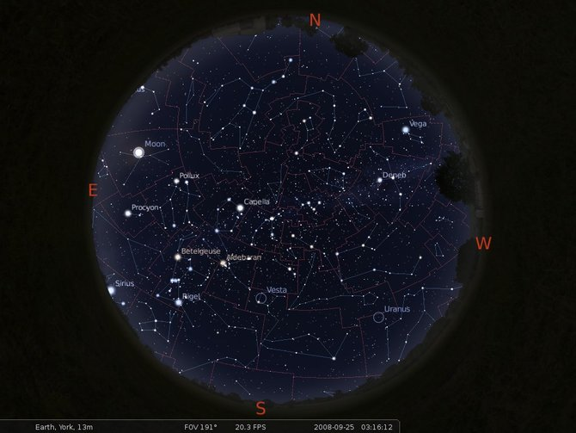
Relational Databases Fundamentals
AN ASTRONOMICAL VIEW
L. Nicastro, INAF-OAS Bologna, 3-7 June 2018
nicastro@iasfbo.inaf.it
http://ross2.iasfbo.inaf.it/wp/imprs/

Slide 2




Where to look
en.wikipedia.org/wiki/Relational_database
www.mysql.com / dev.mysql.com
www.postgresql.org
www.sqlite.org
www.mongodb.com

Slide 3
The Messier catalogue example
Metadata
Id Type Const Mag Ra_h Ra_m Dec_d Dec_p Dist App_size
Int string string float float float float float string string
1 BN Tau 8.2 05 34.5 +22 01.0 6.3 kly 6'x4'
2 GC Aqu 6.3 21 33.5 00 -49.0 36.2 kly 12.9’
3 GC CVn 6.3 13 42.2 +28 23.0 30.6 kly 16.2'
4 GC Sco 6.4 16 23.5 -26 31.5 6.8 kly 26.3'
5 GC Ser 6.2 15 18.6 +02 05.0 22.8 kly 17.4'
6 OC Sco 4.2 17 40.4 -32 13.8 2 kly 33'
7 OC Sco 4.1 17 53.9 -34 47.0 800 ly 80.0'
8 BN Sag 6.0 18 04.1 -24 18.0 5200 ly 90'x40'
9 GC Oph 7.3 17 19.2 -18 31.0 26.4 kly 9.3’
  Data + metadata = file FITS, VOTable, etc.
  Data + metadata + software = DATABASE !

Slide 4
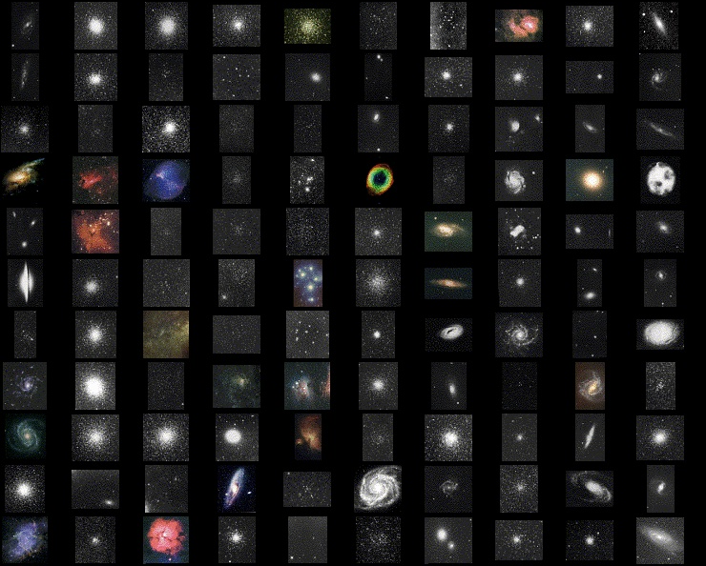
Messier catalogue
11
.
.
.
2
1

Slide 5
Database Management System (DBMS): principles
A database (DB) is a very large collection of related data, usually too large to fit into main memory and often used by many users simultaneously.
A database system implements real-world concepts and applications (entities, properties, relationships).
The invention of this database system has standardized the way data is stored and processed.
Most of the database systems in use today are based on the relational system. However other types of DBs exist, e.g. NoSQL or OODBs.
A relational database consists of a collection of tables (relations) that store particular sets of data among which relationships can exist.
Application in all types of data management: banks, airlines and travel services, web applications, e-commerce, telecommunication, digital libraries, scientific data, etc.

Slide 6
DBMS: principles (2)
The concept of a relational database derives from the principles of relational algebra, realized as a whole by the father of relational databases, E. F. Codd (1970 - A Relational Model of Data for Large Shared Data Banks).
This theory established that “data should be independent of any hardware or storage system, and provided for automatic navigation between the data elements”. In practice, this meant that data should be stored in tables (datasets) and that relationships could/would exist between these different datasets.
In practice, a nowadays relational database is implemented into a software package that serves a number of users connecting and performing queries via internet. In other words it implements a client-server system where the server can also be “distributed”. We can refer to it as a Database Management System (DBMS or RDBMS).
Interaction with a DBMS is performed via queries written using the Structured Query Language (SQL).

Slide 7
DBMS: principles (3)
A DBMS is a software package designed to store, manage and give access to databases.
DBMS compared to a simple file I/O:
Data independence.
Efficient and concurrent data access.
Data security and consistency.
Data integrity under updates.
Uniform data administration.
Reduced application development time.
Recovery from crashes.

Slide 8
Structure of a DBMS
A typical DBMS has a layered architecture.
Connection + user validation
Query Optimization
and Execution
Query syntax control
Relational Operators
Preliminary Tasks
Files and Access Methods
These layers must consider concurrency
control and recovery
(not shown here)
Buffer Management
Disk Space Management
DB

Slide 9
DBMS: reduced application development time
Higher level of data abstraction.
Application portability.
Queries are written in a high level language (SQL) tailored for database applications. Example:
  SELECT starname
  FROM StarCatalogue
  [ WHERE class = 3 ]
  In terms of relational algebra it is:
- what to get
- from which dataset
- optionally applying a filter
SELECT L
FROM R
WHERE C
π_{L} ( σ_{C} (R) )

Slide 10
DBMS: the Structured Query Language (SQL)
Mnemonic, more similar to spoken language, extensible, etc.
For example the syntax of a SELECT query is as follows:
  SELECT starname, ra, de FROM StarCatalogue WHERE class = 3 ORDER BY ra
  SELECT nominates which components of the matches made against the data should be returned.
  FROM indicates the sources for the data against which to find matches.
  WHERE (optional) defines patterns to match against the data.
  ORDER BY (optional) defines a means to order the selected matches.
  Note: produce a relation (table) from a relation.

Slide 11
DBMS: data independence and efficient access
One of the most important benefits of using a DBMS!
Applications can ignore how data is structured and stored.
Logical data independence: Protection from changes in logical structure of data.
Physical data independence: Protection from changes in physical structure of data.
Efficient access.
  Indices allow you to see only the “necessary” portion of data, as opposed to sequential access in files.

Slide 12
DBMS: crashes recovery, security, etc.
If the system crashes in the middle of a transaction, recovery should be possible.
  Ideas: logging, commit/rollback of transactions.
DBMS also implement other features to facilitate administration, such as:
  backup, replication and duplication, access control, privileges etc.
Higher data availability can be obtained using distributed DBs.
  Different architectures can be adopted.
  More complex and requiring more “resources”.

Slide 13
DBMS: transactions - atomicity
Key concept is transaction (Xact), which is an atomic sequence of database actions (reads/writes).
Each transaction, executed completely, must leave the DB in a consistent state if DB is consistent when the transaction begins. Utilize locking of resources and other protocols for guaranteeing consistency.
DBMS ensures atomicity (all-or-nothing property) even if system crashes in the middle of a Xact.
Idea: Keep a log (history) of all actions carried out by the DBMS while executing a set of Xacts (it uses write ahead log − WAL).

Slide 14
DBMS: terminology
Data Models:
A data model is a collection of concepts for describing data:
  Structure, constraints, operations.
A schema is a description of a particular collection of data, using the given data model.
The relational model of data is the most widely used mode, but new models are emerging.
  Main concept: relation, basically a table with rows and columns.
  Every relation has a schema, which describes the columns, or fields.

Slide 15
DBMS: summary
DBMS used to maintain & query large datasets.
Benefits include recovery from system crashes, concurrent access, quick application development, data integrity and security.
Levels of abstraction give data independence.
DBMS have APIs for any programming language.
Note: a DBMS typically has a layered architecture.
Let’s move to some astronomical use cases…

Slide 16
Database server content: Camera Info
Enum types
mysql> SELECT * FROM CameraInfo;
+---------+--------+----------+---------+--------+---------+---------+
| telcode | camera | pixscale | filtern | filter | LambdaC | LambdaW |
+---------+--------+----------+---------+--------+---------+---------+
| X01 | REMIR | 1.221 | Z | Z | | |
| X01 | REMIR | 1.221 | J | J | | |
| X01 | REMIR | 1.221 | H | H | | |
| X01 | REMIR | 1.221 | K | K | | |
| X01 | ROSS | 0.575 | V | V | | |
| X01 | ROSS | 0.575 | R | R | | |
| X01 | ROSS | 0.575 | I | I | | |
| X01 | ROSS | 0.575 | Amici | A | | |
| J13 | RATCAM | 0.1395 | SDSS-U | U | | |
| J13 | RATCAM | 0.1395 | SDSS-G | G | | |
| J13 | RATCAM | 0.1395 | SDSS-R | R | | |
| J13 | RATCAM | 0.1395 | SDSS-I | I | | |
| J13 | RATCAM | 0.1395 | SDSS-Z | Z | | |
+---------+--------+----------+---------+--------+---------+---------+
Notes:
Sky ojects

Slide 17
Database server content: Tel/Camera Info
mysql> SELECT * FROM TelescopeInfo;
+---------+--------------+----------+----------+------+
| telcode | name | lon | lat | elev |
+---------+--------------+----------+----------+------+
| X01 | REM | -70.7345 | -29.2584 | 2377 |
| J13 | LiverpoolTel | -17.8792 | 28.7624 | 2363 |
+---------+--------------+----------+----------+------+
mysql> SELECT camera, group_concat(filtern) as "filter name", GROUP_CONCAT(filter) as f_short FROM CameraInfo GROUP BY camera;
+--------+------------------------------------+-----------+
| camera | filter name | f_short |
+--------+------------------------------------+-----------+
| RATCAM | SDSS-Z,SDSS-I,SDSS-R,SDSS-G,SDSS-U | Z,I,R,G,U |
| REMIR | Z,K,H,J | Z,K,H,J |
| ROSS | R,Amici,V,I | R,A,V,I |
+--------+------------------------------------+-----------+
Notes:
Sky ojects

Slide 18
Database server content: Tel/Camera Info
mysql> SELECT t.name, c.camera, GROUP_CONCAT(c.filter) as filter FROM TelescopeInfo as t, CameraInfo as c WHERE t.telcode=c.telcode GROUP BY c.camera;
+--------------+--------+-----------+
| name | camera | filter |
+--------------+--------+-----------+
| LiverpoolTel | RATCAM | U,G,R,I,Z |
| REM | REMIR | Z,J,H,K |
| REM | ROSS | A,V,R,I |
+--------------+--------+-----------+
Notes:
Sky ojects

Slide 19
Database server content: Tel/Camera Info
mysql> SELECT t.name, GROUP_CONCAT(c.camera) as camera, GROUP_CONCAT(c.filter) as filter FROM TelescopeInfo as t, CameraInfo as c WHERE t.telcode=c.telcode GROUP BY t.name;
+--------------+---------------------------------------------+-----------------+
| name | camera | filter |
+--------------+---------------------------------------------+-----------------+
| LiverpoolTel | RATCAM,RATCAM,RATCAM,RATCAM,RATCAM | U,G,R,I,Z |
| REM | REMIR,REMIR,REMIR,REMIR,ROSS,ROSS,ROSS,ROSS | Z,J,H,K,V,R,I,A |
+--------------+---------------------------------------------+-----------------+
mysql> SELECT t.name, GROUP_CONCAT(DISTINCT c.camera) as camera, GROUP_CONCAT(c.filter) as filter FROM TelescopeInfo as t, CameraInfo as c WHERE t.telcode=c.telcode GROUP BY t.name;
+--------------+------------+-----------------+
| name | camera | filter |
+--------------+------------+-----------------+
| LiverpoolTel | RATCAM | U,G,R,I,Z |
| REM | REMIR,ROSS | Z,J,H,K,V,R,I,A |
+--------------+------------+-----------------+
Notes:
Sky ojects

Slide 20
Database server content: HDR and DB table
mysql> SELECT * FROM FitsHdr2Fld;
+----------+----------+----------+----------------------------------+
| kwdname | fldname | fldtype | flddesc |
+----------+----------+----------+----------------------------------+
| INSTRUME | instrume | STRING | Instrument/camera name |
| CAMERA | instrume | STRING | Instrument/camera name |
| CAT-RA | ras | STRING | Target RA |
| CAT-DEC | decs | STRING | Target Dec |
| OBJECT | object | STRING | Targeted object |
| USERID | pi_coi | STRING | Observer/PI name |
| OBSERVER | pi_coi | STRING | Observer/PI name |
| PI-COI | pi_coi | STRING | Observer/PI name |
| FILTER1 | filter | STRING | Filter code |
| FILTER | filter | STRING | Filter code |
| DATE-OBS | date_obs | DATETIME | Date of observation start |
| CRVAL1 | radeg | DOUBLE | Pointed RA field center |
| CRVAL2 | decdeg | DOUBLE | Pointed Dec field center |
| AZIMUTH | azdeg | DOUBLE | Azimuth of pointing |
| ALTITUDE | eldeg | DOUBLE | Elevation of pointing |
… continue …
Different KWD names map to the same table field
Notes:
Sky ojects

Slide 21
Database server content: Telescopes tables
mysql> SELECT a.kwdname,a.kwdtype,b.fldname,b.fldtype FROM FitsHdrInfo AS a, FitsHdr2Fld AS b WHERE a.kwdname=b.kwdname AND instrume='RATCam';
+----------+---------+----------+----------+
| kwdname | kwdtype | fldname | fldtype |
+----------+---------+----------+----------+
| INSTRUME | STRING | instrume | STRING |
| TELESCOP | STRING | telescop | STRING |
| OBJECT | STRING | object | STRING |
| OBSTYPE | STRING | obstype | STRING |
| CAT-RA | STRING | ras | STRING |
| CAT-DEC | STRING | decs | STRING |
| CRVAL1 | DOUBLE | radeg | DOUBLE |
| CRVAL2 | DOUBLE | decdeg | DOUBLE |
| AZIMUTH | DOUBLE | az | DOUBLE |
| ALTITUDE | DOUBLE | alt | DOUBLE |
| USERID | STRING | pi_coi | STRING |
| FILTER1 | STRING | filter | STRING |
| DATE-OBS | STRING | date_obs | DATETIME |
| MJD | DOUBLE | mjd_obs | DOUBLE |
| EXPTIME | FLOAT | exptime | FLOAT |
| ESTSEE | FLOAT | seeing | FLOAT |
| AIRMASS | FLOAT | airmass | FLOAT |
| MOONDIST | FLOAT | moondist | FLOAT |
| MOONFRAC | FLOAT | moonphas | FLOAT |
Joined tables content
Notes:
Sky ojects

Slide 22
Database server content: Images log table
mysql> DESCRIBE ImgsLog;
+----------+----------------------+
| Field | Type |
+----------+----------------------+
| autoID | int(10) unsigned |
| datein | datetime |
| htmID_6 | smallint(5) unsigned |
| telescop | char(20) |
| instrume | char(8) |
| radeg | double unsigned |
| decdeg | double |
| object | char(20) |
| pi_coi | char(32) |
| filter | char(8) |
| date_obs | datetime |
| exptime | float unsigned |
| seeing | float unsigned |
…
+----------+---------------------+
| Field | Type |
+----------+---------------------+
…
| ras | char(12) |
| decs | char(12) |
| az | double unsigned |
| alt | double |
| gl | tinyint(2) unsigned |
| gb | tinyint(2) unsigned |
| mjdobs | double unsigned |
| airmass | float unsigned |
| moondist | float |
| moonphas | float |
| fname | char(32) |
+----------+---------------------+
Trigger managed, Read from HDR, automatically calc.
Notes:
Sky ojects

Slide 23
Sky objects ⇒ 2-d tables indexing
1-d
Col₁ Col₂ ... Col_{N}
v₁ ... ... ...
v₂ ... ... ...
... ... ... …
v_{N} ... ... ...
2-d
Col₁ Col₂ ... Col_{N} RA Dec
v₁ ... ... ... α₁ β₁
v₂ ... ... ... α ₂ β₂
... ... ... ... ... …
v_{N} ... ... ... α _{N} β_{N}
Catalogue
Rows
Columns
Optical: USNO-B
1,045,913,669
30
Optical: GSC-2.3
945,592,683
53
Infrared: 2MASS
470,992,970
60
X-ray: 2XMM
327,728
318
USNO-B and 2MASS are distributed as files covering 0.1° in Dec each, RA ordered in the slice (no unique index).
Notes:
Sky ojects

Slide 24
Sky objects ⇒ 2-d tables indexing
Possible indexing of a 2-d (3-d, ...) table:
  Split the sphere at your personal convenience – no index
  Index (B-tree) on one single axis (e.g. declination)
  Use an intrinsic (DB) spatial index like the R-tree
  Use a function to map 2-d ⇒ 1-d then use B-tree
The most efficient is the last one, i.e. to have the possibility to allow the DB server to manage data on the sphere (2-d) exactly in the same way as it manages one dimensional data tables ⇒ using B-tree schema.
Various sphere coverage (tessellation) functions have been proposed and used, but for Astronomical purposes the most common are HTM and HEALPix (excluding the geographic-like grids).
Notes:
Sky ojects

Slide 25
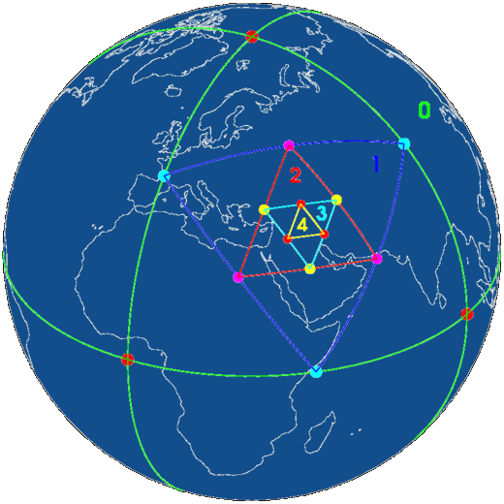
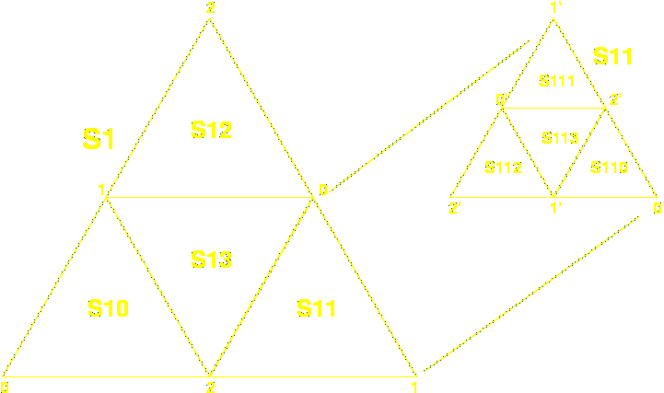
HTM: Hierarchical Triangular Mesh
HTM: www.sdss.jhu.edu/htm/
Invented at Johns Hopkins University for the SDSS survey.
The total Nr of pixels (trixels) in a map is set by depth:
d ∈ [0 , 25] (up to 30 possible!) N_{pix} = 8 ⋅ 4^{d}
ID_{range}: [N_{pix} , 2 ⋅ N_{pix} − 1]
Max res.: 9.0 ⋅ 10¹⁵ px → 7.7'' ⋅ 10⁻³ (24 cm on Earth)

Slide 26
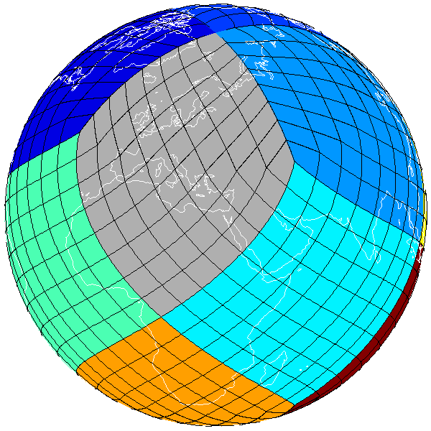
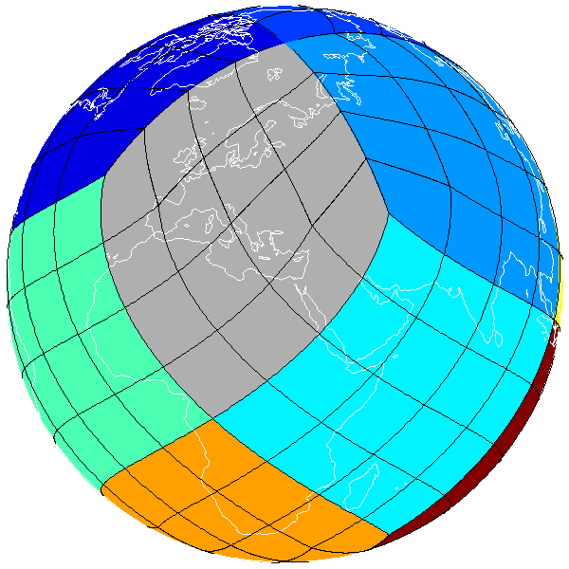
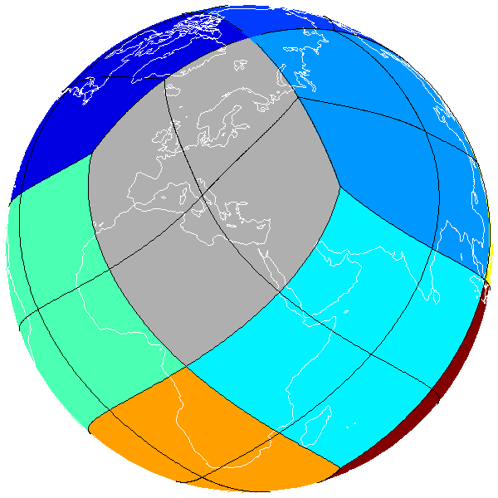
HEALPix: Hierarchical Equal Area isoLatitude
Pixelization
k=3
k=2
k=1
HEALPix: healpix.jpl.nasa.gov
Invented at ESO for COBE. Also used by WMAP, Planck, etc.
The total Nr of pixels in a map is set by order: k ∈ [0 , 29]
N_{side} = 2^{k} N_{pix} = 12 ⋅ N²_{side}
ID_{range}: [0 , N_{pix} – 1] Ω_{pix} = π / (3 × N²_{side})
Max res.: 3.46 ⋅ 10¹⁸ pix → 3.93'' ⋅ 10⁻⁴ (1.2 cm on Earth)

Slide 27
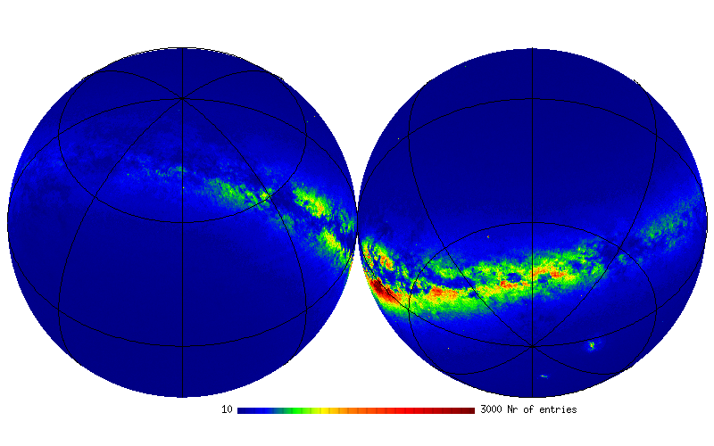
UCAC 4: sky objects density
N_{obj} = 113,780,000
K = 8 N_{pix}= 786,432
Ω_{pix} ~ 14’
Orthographic Equatorial
10
3000
Notes:
Sky ojects

Slide 28
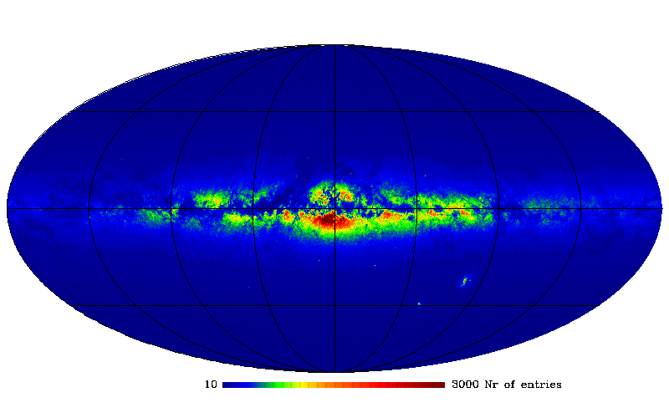
UCAC 4: sky objects density
N_{obj} = 113,780,000
K = 8 N_{pix}= 786,432
Ω_{pix} ~ 14’
Mollweide Galactic
10
3000
Notes:
Sky ojects

Slide 29
HTM and HEALPix facts
Typically used pixelization resolutions:
− HTM: 6, 8, 10, 12 − HEALPix: 6, 8, 10, 12
d / k | Npix | <Area> | Obj/pix | Bytes
6 | 32,768 | 1.26 deg² | 89,290 | 2
8 | 524,288 | 283 arcmin² | 5,580 | 3
10 | 8,388,608 | 18 arcmin² | 348 | 3
12 | 134,217,728 | 1 arcmin² | 21 | 4
HTM
6 | 49,152 | 0.84 deg² | 59,526 | 2
8 | 786,432 | 189 arcmin² | 3,720 | 3
10 | 12,582,912 | 12 arcmin² | 232 | 3
12 | 201,326,592 | 0.7 arcmin² | 14 | 4
HEALPix
For generic use, ~1000 Obj/Pix gives best performance
Notes:
Sky ojects

Slide 30
DIF: dynamic indexing facility
(DIF indexed) StarCat table
DIF.dif table
… | RA | Decl | … | htmID_6
param | ID | full
DIF added field+index
Dynamically generated
JOIN
htmID_6 = ID
StarCat_htm_6 VIEW
… | RA | Decl | … | htmID_6
Examples:
SELECT * From StarCat_htm_6 Where DIF_Circle( 82.5,12.0, 6 );
SELECT HEALPLookup(0,8,RA,Decl)
From GSC23_htm_6 Where DIF_Rect(20.1,30.5,8);
Center (°) & radius (´)

Slide 31
DIF: MySQL extension
UDF Functions:
DIF.getHTMDepth (db, tab)
DIF.getHEALPOrder (db, tab)
DIF.getHEALPNested (db, tab)
DIF.getRa (db, tab)
DIF.getDec (db, tab)
HTMBary (d, ID)
HTMBaryC (d, RA, Dec)
HTMBaryDist (d, ID, RA, Dec)
HTMNeighb (d, ID)
HTMNeighbC (d, RA, Dec)
HEALPBary (s, k, ID)
HEALPBaryC (s, k, RA, Dec)
HEALPBaryDist (s, k, ID, RA, Dec)
HEALPNeighb (s, k, ID)
HEALPNeighbC (s, k, RA, Dec)
Sphedist (R1 ,D1, R2, D2)
HTMLookup (d, RA, Dec)
HEALPLookup (s, k, RA, Dec)
HTMsNeighb (d1, ID_d2, d2)
DIF engine Functions:
DIF_Circle (RA, Dec, R)
DIF_Rect (RA, Dec, S1, S2)
DIF_RectV (RA1, Dec1, ...)
DIF_NeighbC (RA, Dec)
DIF_sNeighb (d1, ID_d2, d2)
DIF_setHTMDepth (d)
DIF_setHEALPOrder (s, k)
DIF_FineSearch (var)
DIF_Sphedist (RA1, Dec1, RA2, Dec2)
DIF_cpuTime(), DIF_clear()
Select HEALPLookup(0,8,RA,Dec) From V Where DIF_Rect(0,0,20);

Slide 32
The Messier table creation
  Here we use the MySQL client command to connect to the MySQL server. Use user “root” for convenience.
  mysql --local-infile=1 -u root –p [ DIF ]
  Enter password:
  mysql> USE DIF;
mysql> SHOW TABLES;
  +---------------+
  | Tables_in_dif |
  +---------------+
  | Messier |
  | TypeDescr |
  | dif |
  | tbl |
  +---------------+

Slide 33
The Messier table creation
  Drop table if already there, then create it (no prompt).
  DROP TABLE IF EXISTS Messier;
  CREATE TABLE Messier (
  M int NOT NULL,
  Type CHAR(2) DEFAULT '**',
  Const CHAR(3) DEFAULT '***',
  Mag FLOAT,
  Ra FLOAT, Decl FLOAT,
  Dist CHAR(20),
  App_size CHAR(20) DEFAULT 'unknown',
  PRIMARY KEY(M),
  INDEX(Type)
  );

Slide 34
The Messier table creation
  Read from an ASCII file using LOAD DATA INFILE (no prompt).
  LOAD DATA LOCAL INFILE './messier.tsv'
  INTO TABLE Messier;
  [ SELECT * FROM Messier; ]
  UPDATE Messier SET Ra = Ra * 15.0;
  [ SELECT * FROM Messier; ]
  Also create an object type code table.
  CREATE TABLE TypeDescr(
  Type CHAR(2), Descr CHAR(20),
  PRIMARY KEY(Type)
  );
  LOAD DATA LOCAL INFILE './legend.tsv'
  INTO TABLE TypeDescr;

Slide 35
The Messier table creation
  The “legend” ASCII file load into TypeDescr.
  OC Open Cluster
  GC Globular Cluster
  GX Galaxy
  PN Planetary Nebula
  BN Bright Nebula
  DN Dark Nebula
  *2 Double Star
  *C Star Cloud
Note that the default field separator is the (invisible) <Tab> (\t) and the end line character is <NewLine> (\n).
Can use any separator/terminator using the FIELDS/LINES TERMINATED BY clause. More can be given.
\t
\n

Slide 36
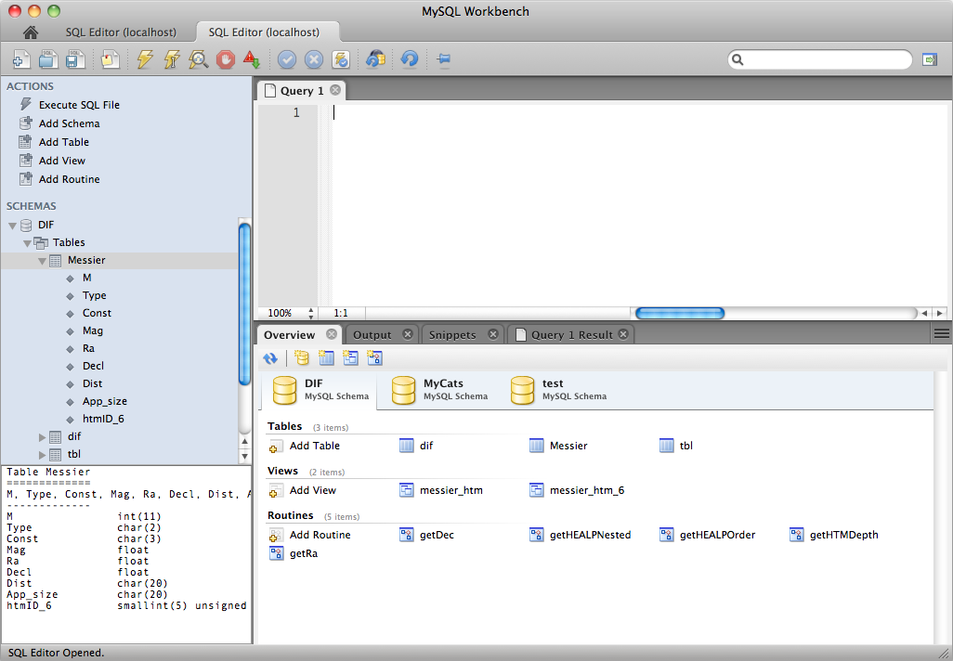
DBMS: the Messier catalogue example
  Data + metadata + software = DATABASE !
database
tables
views
routines

Slide 37
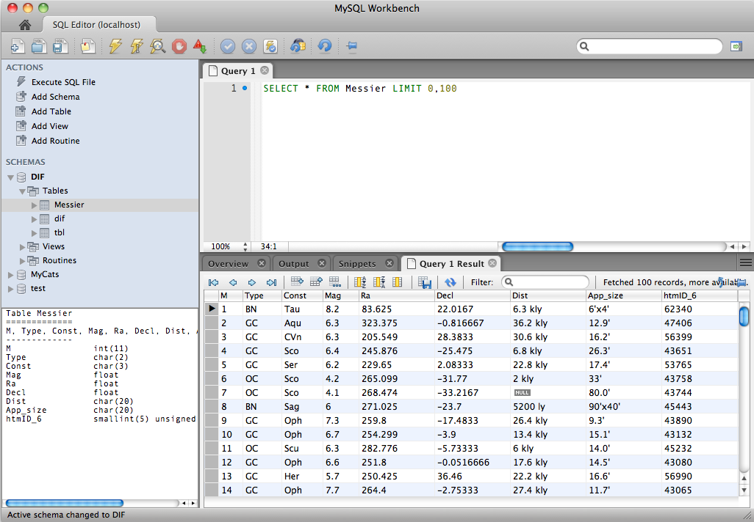
DBMS: the Messier catalogue example
NULL value.
Not 0 or blank!
Field, column,
attribute
Entry, row, entry,
observation, tuple

Slide 38
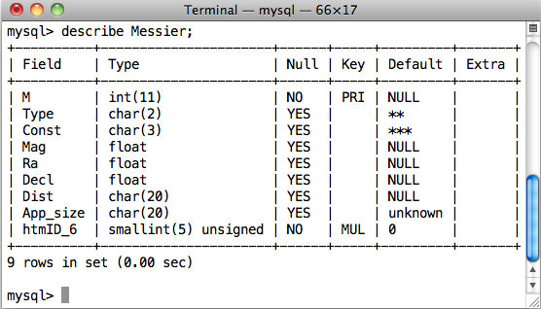
DBMS: the Messier table structure
  Must know what type of query can be performed on the fields.
Data Type
Default value
Primary Key
Foreign Key

Slide 39
How to query a database
  Server based DBs require connection and authentication;
  then you can start querying using the SQL.
  Via dedicated GUI interface.
  Also allows DB management.
  Via terminal.
  Type your query (command) at the prompt and see the output.
  Via custom applications using API libraries.
  Transfer data from/to your software program.
  ODBC (Open DB Connectivity) drivers ➔ translation layer between applications and DBMS.
  Can use (almost) any programming language to query a DBMS.

Slide 40

How to query a database
DBMS
_ o x
A
B
C
Your query output
C1 C2 C3 …
GUI
_ o x
$ mysql –u me –ppass myDB –e “select c1, c2, c5 from myTab where c4 <= 0”
$ mysql –u me –p myDB
mysql> SELECT *
FROM my_table
WHERE c3 > 10;
DBConn db;
db.connect(usr,pass,db,host);
Query qry(&db);
qry.query(“SELECT * FROM my_table WHERE c3 > 10”);
database
Shell
Program

Slide 41
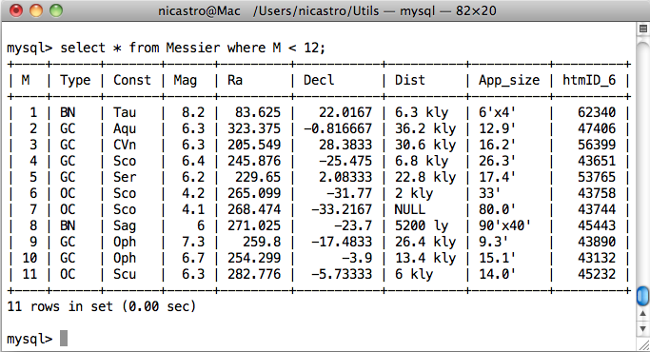
How to query a database
  Via terminal (MySQL monitor / client).

Slide 42
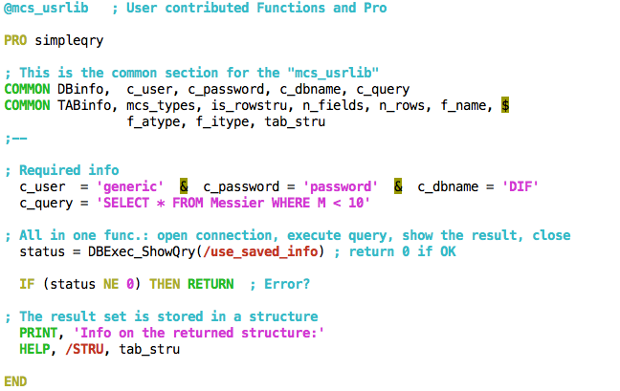
How to query a database
  Via custom applications using API libraries. Here IDL (custom).

Slide 43
SQL: Structured Query Language
  Can also be used to build scripts, functions, procedures.
  Most common query statements: SELECT, INSERT, DELETE, UPDATE.
    Note: INSERT, DELETE are “record-based” operations.
  Implemented for the first time in 1970 (with the name SEQUEL, (Structured English Query Language) for the IBM “System R”.
  Adopted as standard ANSI (1986) and ISO (1987) with the name of SQL (pronounced “ES-Q-EL”);
  There exist various versions:
    SQL-86, SQL-87 (adopted by ISO)
    SQL-89
    SQL-92 (the most commonly used)
    SQL-99 (addition of regular expressions, subqueries, triggers, etc.)
    SQL-2003 (XML and other advanced functionalities. Not free!

Slide 44
SQL extensions and DB servers
  Each DB server implements it’s own extensions. Some are generally available, other are very specific. Relational DB servers commonly used include: Oracle, Sybase, SQLServer, DB2, MySQL, PostgreSQL, SQLite, …
    We have used (and will use) MySQL (or MariaDB) as a reference. It is open source and runs on Linux, MacOS, Windows, Solaris, HPUX.
    Pre-compiled installations are very simple to install. Here we’ll show the source code installation procedure. I suggest you try it yourself. I can help in case of troubles. Just remember to create the “root” account. It is used for all the management aspects related to the DB server.
  SQLite is a zero-configuration DB ➔ no client/server architecture.
    Can be used to manage Application Files. Rather than using fopen() to write XML or some proprietary format into disk files used by your application, use an SQLite database instead. You'll avoid having to write and troubleshoot a parser, your data will be more easily accessible and cross-platform, and your updates will be transactional.

Slide 45
SQL: the language Statements
DDL: is abbreviation of Data Definition Language.
  It is used to create and modify the DB structure or schema. Examples: CREATE, ALTER, DROP.
DML: abbreviation of Data Manipulation Language.
  It is used for managing data within schema objects, e.g. retrieve, store, modify, delete, insert and update data. Examples: SELECT, UPDATE, INSERT.
DCL: is abbreviation of Data Control Language.
  It is used to create roles, permissions, and referential integrity as well as to control access to database by securing it. Examples: GRANT, REVOKE.
TCL: is abbreviation of Transactional Control Language.
  It is used to manage different transactions occurring within a database. Examples: COMMIT, ROLLBACK.

Slide 46
DDL: Data Definition Language
Create and modify the structure of database objects:
  CREATE - to create objects in the database
  ALTER - alters the structure of the database
  DROP - delete objects from the database
  TRUNCATE - remove all records from a table, including all spaces allocated for the records are removed
  COMMENT - add comments to the data dictionary
  RENAME - rename an object

Slide 47
DML: Data Manipulation Language
Manage data within schema objects.
  SELECT - retrieve data from the a database
  INSERT - insert data into a table
  UPDATE - updates existing data within a table
  DELETE - deletes all records from a table, the space for the records remain
  CALL - call a SQL or (other language) subprogram
  LOCK TABLE - control concurrency
  REPLACE/MERGE, DO, HANDLER, LOAD DATA INFILE
  …

Slide 48
DML: Data Manipulation Language (2)
  Prepared Statements:
    PREPARE, EXECUTE, DEALLOCATE PREPARE
  Compound-statements:
    BEGIN … END, DECLARE, SELECT … INTO
  Cursors:
    OPEN, FETCH, CLOSE
  Flow Control Constructs:
    IF, CASE, LOOP, LEAVE, ITERATE, REPEAT, WHILE
    RETURN

Slide 49
DCL: Administration Statements
  Account management: users, permissions, view status, etc.
    CREATE USER, DROP USER, RENAME USER, GRANT, REVOKE, SET PASSWORD, e.g.
  GRANT - gives user's access privileges to database
  REVOKE - withdraw access privileges given with the GRANT command
  Table maintenance:
    ANALYSE TABLE, CHECK TABLE, REPAIR TABLE
  Plugin and User-Defined Function Statements:
    CREATE/DROP FUNCTION, INSTALL/UNINSTALL PLUGIN

Slide 50
SQL: Utility Statements and common clauses
  View status, etc.:
    SET, SHOW, DESCRIBE ( SHOW COLUMNS FROM ), EXPLAIN, HELP, USE, FLUSH, KILL, RESET, e.g.
    SHOW item – provide information about a long list of things: databases, tables, view, columns, functions, status, about the server, …
    EXPLAIN item – explain query execution, access path to data, …EXPLAIN SELECT the_Query;
  Common SELECT clauses:
    LIMIT, HAVING, GROUP BY, ORDER BY, INTO OUTFILE, BETWEEN, IN
Aggregation

Slide 51
SQL: Functions and Operators
Most of them are SQL standard, other are specific to each DB server. Below those for MySQL.
Operators (with Type Conversion in Expression Evaluation)
Control Flow Functions ( IF(), CASE )
String Functions, Numeric Functions and Operators
Date and Time Functions
Full-Text Search Functions
Cast Functions and Operators
XML Functions
Bit Functions
…continue…

Slide 52
SQL: Functions and Operators
…continued
Encryption and Compression Functions
Information / miscellaneous Functions
Functions and Modifiers for Use with GROUP BY Clauses
Spatial Extensions
Precision Math
  Note:
  All commands and column names are case insensitive.
  DB names and Table names “can” be case sensitive, depending on OS and configuration of the server.

Slide 53
The importance of indexing
  Except for small tables and for table which will need to be ready (almost) at every query, you must always index the table on one or more columns, either as a compound single index or with multiple indices.
  There are various types of index (or key):
    Primary key
    Unique key (superkey, compound key, composite key, alternate key)
    Multiple key (foreign key)
  Note:
  Generally a key can be the combination of more columns.
  Keys have several constraints.
  The foreign key identifies 1 or more columns in one (referencing) table that refers to a set of columns in another (referenced) table. The columns in the referencing table must be the primary key or other candidate key in the referenced table.

Slide 54
The importance of indexing
Primary key constraints:
A set of attributes is a key for a relation if:
  No two distinct rows can have the same values in all key fields.
  A proper subset of the key attributes is not a key.
Superkey:
  It is a set of attributes within a table whose values can be used to uniquely identify a tuple.
  A proper subset of a superkey may be a superkey.
If multiple keys, one of them is chosen to be the primary key.
  e.g.: PRIMARY KEY (StarCat) = <StarID>

Slide 55
The importance of indexing
Candidate keys (SQL: Unique):
Keys that are not primary keys are candidate keys.
Specified in SQL using UNIQUE.
Attribute of unique key may have NULL values !
Eg: StarCat (starID, coordID)
  PRIMARY KEY (StarCat) = <starID>
CANDIDATE KEY (StarCat) = <coordID>

Slide 56
Back to Messier: let’s use indexing
  If a query does not use an indexed column, then the entire table has be scanned ➔ no help!
Indexing examples:
ALTER TABLE Messier ADD UNIQUE KEY (M);
ALTER TABLE Messier ADD INDEX (Type);
ALTER TABLE Messier ADD INDEX pos(htmID_6,Ra);
To show the indices:
SHOW INDEX FROM Messier;
The field to look at is Cardinality: it tells how many distinct rows that index points to in the table. The cardinality of PRIMARY / UNIQUE keys is exactly the number of rows in the table, i.e. each key points to a single entry. Each multiple key refers to N_rows / Cardinality, i.e. it gives the table grouping factor.

Slide 57
Example queries using indices
Examples:
SELECT Ra, Decl, Mag FROM Messier WHERE M=33;
SELECT M, App_size FROM Messier WHERE M BETWEEN 10 AND 13;
SELECT COUNT(*) FROM Messier WHERE Type = 'GC';
SELECT COUNT(Mag) AS N, AVG(Mag) AS Mag_ave
FROM Messier WHERE Type ='PN’;
SELECT COUNT(*) AS N, ROUND(AVG(Mag)) AS IMag_ave
FROM Messier WHERE Type =’GX’ AND Decl > 0;

Slide 58
A simple JOIN
Examples:
SELECT Messier.M, Messier.Type, Messier.App_size, Messier.Const, TypeDescr.Descr
FROM Messier LEFT JOIN TypeDescr
ON Messier.Type = TypeDescr.Type LIMIT 5;
+---+------+----------+-------+------------------+
| M | Type | App_size | Const | Descr |
+---+------+----------+-------+------------------+
| 1 | BN | 6'x4' | Tau | Bright Nebula |
| 2 | GC | 12.9' | Aqu | Globular Cluster |
| 3 | GC | 16.2' | CVn | Globular Cluster |
| 4 | GC | 26.3' | Sco | Globular Cluster |
| 5 | GC | 17.4' | Ser | Globular Cluster |
+---+------+----------+-------+------------------+
Selections on sky regions?
See DIF package.

Slide 59
SQL functions / procedures
DELIMITER //
DROP FUNCTION IF EXISTS skydist//
CREATE FUNCTION skydist(a1 DOUBLE, b1 DOUBLE, a2 DOUBLE,
b2 DOUBLE) RETURNS DOUBLE
BEGIN
DECLARE d2r, a1r, b1r, a2r, b2r, radiff, cosdis, dist DOUBLE;
SET d2r = 0.017453292519943;
SET a1r = a1*d2r; SET b1r = b1*d2r;
SET a2r = a2*d2r; SET b2r = b2*d2r;
SET radiff = ABS(a2r-a1r);
IF (radiff > pi()) THEN
SET radiff = 2e0 * pi() - radiff;
END IF;
SET cosdis = sin(b1r)*sin(b2r) + cos(b1r)*cos(b2r)*cos(radiff);
SET dist = acos(cosdis)/d2r;
RETURN dist;
END//

Slide 60
SQL functions / procedures
DROP PROCEDURE IF EXISTS hadec2altaz;
DELIMITER //
CREATE PROCEDURE hadec2altaz(IN ha DOUBLE, IN decl DOUBLE, IN lat DOUBLE, OUT alt DOUBLE, OUT az DOUBLE)
BEGIN
DECLARE d2r, sh, ch, sd, cd, sl, cl DOUBLE;
DECLARE x, y, z, r DOUBLE;
SET d2r = pi()/180.0;
SET sh = sin(ha*d2r); SET ch = cos(ha*d2r);
SET sd = sin(decl*d2r); SET cd = cos(decl*d2r);
SET sl = sin(lat*d2r); SET cl = cos(lat*d2r);
SET x = - ch * cd * sl + sd * cl; SET y = - sh * cd;
SET z = ch * cd * cl + sd * sl; SET r = sqrt(x*x + y*y);
SET az = atan(y,x) / d2r; SET alt = atan(z,r) / d2r;
IF (az < 0) THEN
SET az = az + 360;
END IF;
END//

Slide 61
SQL functions / procedures
Examples:
SELECT skydist(170.2, 32.4, 171, 33) AS dist_arcmin;
+-------------+
| dist_arcmin |
+-------------+
| 54.1 |
+-------------+
SELECT skydist(Ra, Decl, 83, 22)/60 AS dist_deg
FROM Messier WHERE M=1;
+-------------------+
| dist_deg |
+-------------------+
| 0.579695994000773 |
+-------------------+

Slide 62
SQL functions / procedures
Examples:
SET @ra1=0, @de1=0;
SELECT Ra, Decl INTO @ra1, @de1 FROM Messier WHERE M=1;
SELECT skydist(Ra, Decl, @ra1, @de1)/60 AS dist_deg
FROM Messier WHERE M>1 AND M<5;
+------------------+
| dist_deg |
+------------------+
| 118.186206837217 |
| 104.661086889574 |
| 163.403397387795 |
+------------------+
SELECT M, Type, skydist(Ra, Decl, @ra1, @de1)/60 AS dist
FROM Messier HAVING dist < 10;
+----+------+------------------+
| M | Type | dist |
+----+------+------------------+
| 1 | BN | 0 |
| 35 | OC | 8.26280575133499 |
+----+------+------------------+

Slide 63
SQL functions / procedures
Examples:
CALL hadec2altaz(270, 46, 44, @alt, @az);
SELECT @alt, @az;
+------------------+------------------+
| @alt | @az |
+------------------+------------------+
| 29.9798507651043 | 53.3176415064057 |
+------------------+------------------+
CALL hadec2altaz(180, 46, 44, @alt, @az);
+-----------------------+------+
| @alt | @az |
+-----------------------+------+
| -6.36110936292703e-15 | 360 |
+-----------------------+------+
SELECT * FROM INFORMATION_SCHEMA.ROUTINES WHERE routine_name like 'sky%';

Slide 64
Aggregating
Examples:
SELECT propID, object, pi_coi, filter, exptime,
COUNT(exptime) as Nobs, SUM(exptime) as TotExp,
DATE(date_obs) as Day
FROM Obslog WHERE date_obs>'2011-04-16 22:00:00' AND
date_obs<'2011-04-17 12:00:00’
GROUP BY propid, object, pi_coi, filter, exptime
propID object pi_coi filter exptime Nobs TotExp Day
------ ------------- ------------- ------- -------- ------ ------- ----------
5 SA098_978 REM_Team GRI 5 7 35 2011-04-16
5 SA098_978 REM_Team H 5 7 35 2011-04-16
5 SA098_978 REM_Team I 20 8 160 2011-04-16
5 SA098_978 REM_Team J 5 7 35 2011-04-16
23007 sdss15724 Elena_Pancino R 180 3 540 2011-04-17
23007 sdss15724 Elena_Pancino J 20 63 1260 2011-04-17
23038 DP_Cru Marcio_Catelan K 10 7 70 2011-04-17
23038 DP_Cru Marcio_Catelan V 5 1 5 2011-04-17
…

Slide 65
Aggregating
Examples:
SELECT propID, COUNT(exptime) AS Nobs, SUM(exptime) AS TotExp
FROM Obslog WHERE date_obs>'2011-04-16 22:00:00' AND
date_obs<'2011-04-17 12:00:00’
GROUP BY propID ORDER BY TotExp [ ASC | DESC ];
| propID | Nobs | TotExp |
+--------+------+--------+
| 23071 | 24 | 24 |
| 7 | 11 | 55 |
| 5 | 59 | 655 |
| 23012 | 30 | 960 |
| 23062 | 22 | 1470 |
| 23073 | 24 | 1530 |
| 23030 | 87 | 1722 |
| 23735 | 120 | 2120 |
| 23038 | 120 | 2475 |
| 23007 | 72 | 2880 |
| 23027 | 117 | 3510 |
| 23011 | 196 | 5880 |
| 23047 | 210 | 6300 |

Slide 66
Views
DROP VIEW IF EXISTS Messier_view;
CREATE VIEW Messier_view AS
SELECT Messier.M,
TypeDescr.Descr AS Descr,
Messier.Const,
Messier.Mag,
Messier.Ra,
Messier.Decl,
radec2alt(Messier.Ra, Messier.Decl, 44.5, 11.3, -1,
now()) AS Alt,
radec2az( Messier.Ra, Messier.Decl, 44.5, 11.3, -1,
now()) AS Az,
Messier.Dist,
Messier.App_size
FROM Messier LEFT JOIN TypeDescr
ON Messier.Type = TypeDescr.Type
ORDER BY Descr, M;

Slide 67
Views
DESCRIBE Messier_view;
+----------+----------+------+-----+---------+-------+
| Field | Type | Null | Key | Default | Extra |
+----------+----------+------+-----+---------+-------+
| M | int(11) | NO | | NULL | |
| Descr | char(20) | YES | | NULL | |
| Const | char(3) | YES | | *** | |
| Mag | float | YES | | NULL | |
| Ra | float | YES | | NULL | |
| Decl | float | YES | | NULL | |
| Alt | double | YES | | NULL | |
| Az | double | YES | | NULL | |
| Dist | char(20) | YES | | NULL | |
| App_size | char(20) | YES | | unknown | |
+----------+----------+------+-----+---------+-------+

Slide 68
Views
SELECT * FROM Messier_view limit 4;
| M | Descr | Const | Mag | Ra | Decl | Alt
| Az | Dist | App_size |
| 73 | NULL | Aqu | 9 | 314.726 | -11.365 | -62.218887202434 | 341.173761681747 | -- | 2.8' |
| 1 | Bright Nebula | Tau | 8.2 | 83.625 | 22.0167 | 50.4744339376439 | 258.497278567727 | 6.3 kly | 6'x4' |
| 8 | Bright Nebula | Sag | 6 | 271.025 | -23.7 | -57.078773558122 | 74.4445883563204 | 5200 ly | 90'x40’ |
| 17 | Bright Nebula | Sag | 7.5 | 275.175 | -15.8333 | -55.0517205008551 | 59.1020440792511 | 5000 ly | 11 |

Slide 69
How to insert data files into a DB
  For ASCII (text) files several methods are available within the various DB servers. A lot of external tools also exist. XML files are also managed automatically by MySQL:
  LOAD DATA [LOCAL] INFILE 'data.txt' INTO TABLE db2.my_table;
  LOAD XML INFILE 'data.xml' INTO TABLE db2.my_table;
  VOTables: either considered as XML or using custom programs (see examples)
  For FITS files can use custom programs, see e.g. MCS.
  It is easy to write simple programs to import into DBs binary files. Will show examples and make use case exercises.

Slide 70
How to export data from one DB to another
  There are many possibilities, depending if a full table has to be exported or just a subset:
    Direct transfer: INSERT INTO DB2.tab1 SELECT * FROM DB1.tab1
  Export to file, e.g. from shell: mysql -u usr -p --xml -e “select * from mytable” mydb > file.xml
  If different server a re involved then it depends on the size of the data to export. It is possible to:
    On server A export to a file the data and then restore them on the server B, e.g. from shell: mysqldump –u root –p DBName TableName
    From server B perform the query on server A and store/save the data (all at once or in chunks) into a local file or directly into the DB table, e.g. SELECT * FROM Table INTO OUTFILE ‘/path/tofile.tsv’;
    Simply copy the DB disk files from server A into the DB disk on server B (a DB = directory, a table = one or more files).
    Write a program that connects to the two DBs (read from A write to B).

Slide 71
Import/export examples: SQL
    LOAD DATA INFILE ’mydata.txt' INTO TABLE mytable (col1,col2,...);
    LOAD DATA LOCAL INFILE 'data.csv' INTO TABLE tbl_name
    FIELDS TERMINATED BY ',' OPTIONALLY ENCLOSED BY '"'
    LINES TERMINATED BY '\r\n'
    IGNORE 1 LINES;
    LOAD DATA INFILE 'file.tsv'
    INTO TABLE t1
    (column1, @var1)
    SET column2 = @var1/100;
    LOAD DATA INFILE 'file.tsv'
    INTO TABLE t1
    (column1, column2)
    SET column3 = CURRENT_TIMESTAMP;

Slide 72
Import/export examples: SQL
    Direct transfer:
      INSERT INTO DB2.tab1 SELECT * FROM DB1.tab1
      INSERT INTO DB2.tab1 SELECT * FROM DB1.tab2 WHERE c1 BETWEEN 1 AND 100;
    Saving data into an ASCII file:
      SELECT * FROM Table INTO OUTFILE ‘/path/out_file.tsv’;
      SELECT c1,c3,c4,c6/10 FROM Table INTO OUTFILE ‘/path/out_file.tsv’;
      …
      Note: must give full path and the output directory must be writeable to the user mysql. So you either from the shell you do a preliminary “chmod o+w out_dir”, or use a directory writeble to all, like /tmp

Slide 73
Import/export examples: shell commands
  mysql -u root -p --xml -e “select * from mydb.mytable” > file.xml
  mysqldump –u root -p DBName TableName
  mysql -u root -p --html -e “select * from mydb.mytable” > file.html
  …
    Simply copy the DB disk files from server A into the DB disk on server B (a DB = directory, a table = one or more files):
      scp /usr/local/mysql/data/test/simpleBSC* usr@host:/dest/db
  Note: any user with SELECT permission can issue these commands, not just root.

Slide 74
Import/export examples: custom programs
    Direct transfer (see examples)

Slide 75
INFORMATION_SCHEMA database
INFORMATION_SCHEMA tables:
http://dev.mysql.com/doc/refman/5.7/en/information-schema.html
INFORMATION_SCHEMA index:
http://dev.mysql.com/doc/refman/5.7/en/dynindex-is.html
mysql> select * from information_schema.tables where table_name='UCAC_2orig';
mysql> select * from information_schema.columns where table_name='UCAC_2orig';
mysql> SELECT table_name FROM INFORMATION_SCHEMA.TABLES where table_schema='mpe2014' AND table_type != 'View';
mysql> SELECT * FROM INFORMATION_SCHEMA.ROUTINES WHERE routine_name like 'sky%';

Slide 77
User Defined Functions (UDFs)
See:
http://dev.mysql.com/doc/refman/5.7/en/adding-functions.html
http://dev.mysql.com/doc/refman/5.7/en/create-function-udf.html
CREATE [AGGREGATE] FUNCTION function_name RETURNS {STRING|INTEGER|REAL|DECIMAL}
SONAME shared_library_name;
DROP {PROCEDURE | FUNCTION} [IF EXISTS] sp_name
DROP FUNCTION function_name;
mysql> select * from mysql.func;
Demo functions (in udf_astro):
CREATE FUNCTION skysepc RETURNS REAL SONAME 'udf_astro.so';
CREATE FUNCTION radec2gl RETURNS REAL SONAME 'udf_astro.so';
CREATE FUNCTION radec2gb RETURNS REAL SONAME 'udf_astro.so';
CREATE FUNCTION radec2el RETURNS REAL SONAME 'udf_astro.so';
CREATE FUNCTION radec2eb RETURNS REAL SONAME 'udf_astro.so’;

Slide 78
DIF: HTM multi-depth progressive erosion
Example with 3 depths
(don’t need to be contiguous)
Partial
Full

Slide 79
Some client access examples
Let’s see how to interact with the MySQL server from some programming languages. Basically it is possible from any language.
C language
Python
PHP

Slide 80
Client example: Python
Simple SELECT query with output printing. We assume field names are known.
#!/usr/bin/python
# -*- coding: utf-8 -*-
import MySQLdb as mdb
con = mdb.connect('localhost', 'mpe18usr', 'mpe18pass', 'mpe18db')
with con:
cur = con.cursor(mdb.cursors.DictCursor)
cur.execute("SELECT * FROM BSC LIMIT 4")
rows = cur.fetchall()
for row in rows:
print row["Name"], row["RA"], row["Dec"], row["Vmag"]

Slide 81
Client example: PHP
Simple SELECT query with output printing. Errors not managed.
<?php // We use the Bright Star Catalogue (BSC)
$mysqli = new mysqli('localhost', 'mpe18usr', 'mp18pass', 'mpe18db');
$sql = "SELECT name, ra, de, vmag FROM BSC ORDER BY vmag LIMIT 8";
$result = $mysqli->query($sql);
echo "<table><tr>\n";
while ($finfo = $result->fetch_field())
echo '<th>'. $finfo->name .'</th>'; // field names
echo '</tr>';
while ($star = $result->fetch_row()) { // data rows
echo "<tr>\n";
foreach ($row as $value)
echo "<td nowrap>$value</td>";
echo "</tr>\n";
}
echo "</tr></table>\n"; // end of the table
if ($ressult) $result->free(); // clean the data object
$mysqli->close(); // close the server connection
?>

Slide 82
Client example: C
Simple information query about MySQL client:
#include <my_global.h>
#include <mysql.h>
int main(int argc, char **argv)
{
printf("MySQL client version: %s\n", mysql_get_client_info());
exit(0);
}

Slide 83
Client example: C – 2
Simple SELECT query with output printing. Errors not managed.
#include <my_global.h>
#include <mysql.h>
int main(int argc, char **argv)
{
MYSQL *con = mysql_init(NULL);
mysql_real_connect(con, "localhost", "user", "pass", "db", 0, NULL, 0);
mysql_query(con, "SELECT * FROM Messier");
MYSQL_RES *result = mysql_store_result(con);
int num_fields = mysql_num_fields(result); // number of columns
MYSQL_ROW row;
while ((row = mysql_fetch_row(result))) { // for each returned row
for(int i = 0; i < num_fields; i++)
printf("%s ", row[i] ? row[i] : "NULL");
printf("\n");
}
mysql_free_result(result);
mysql_close(con);
exit(0);
}

Slide 84
SQL queries
    Subqueries with ANY, IN, or SOME:
    Subqueries with ALL:
    SELECT s1 FROM t1 WHERE s1 > ALL (SELECT s1 FROM t2);
    Finally, the expression is TRUE if table t2 is empty. So, the following expression is TRUE when table t2 is empty:
    SELECT * FROM t1 WHERE 1 > ALL (SELECT s1 FROM t2);
    Note:
    NOT IN is an alias for <> ALL. Thus, these two statements are the same:
    SELECT s1 FROM t1 WHERE s1 <> ALL (SELECT s1 FROM t2);
    SELECT s1 FROM t1 WHERE s1 NOT IN (SELECT s1 FROM t2);

Slide 85
SQL queries
    Row Subqueries:
    Prepared queries:
    …

Slide 86
RDBMS web access / usage
Modern web sites tipically use 4 resources
Web site
CSS3
Appearance
JavaScript
Content manag.
HTML5
Scheleton
PHP
Server side oper.

Slide 87
RDBMS web access / usage
Some JavaScript libraries for web graphics
amCharts: https://www.amcharts.com/
  See examples page: https://www.amcharts.com/demos/
Plotly.js: https://plot.ly/javascript/
D3.js: https://d3js.org/
Flot: http://www.flotcharts.org/
Bokeh (python oriented): http://bokeh.pydata.org/en/latest/
… and many more

